Slide 1


Reducing Energy and Carbon
in the Council
March 2026

Slide 2
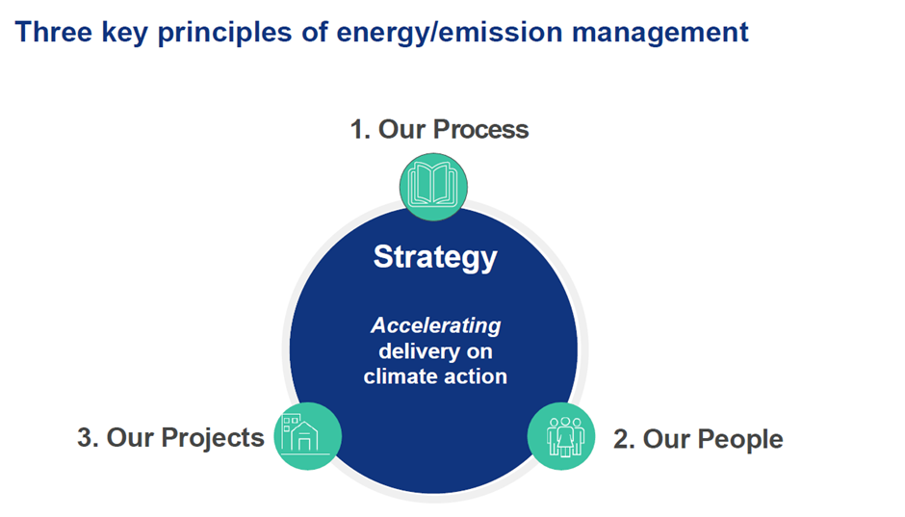
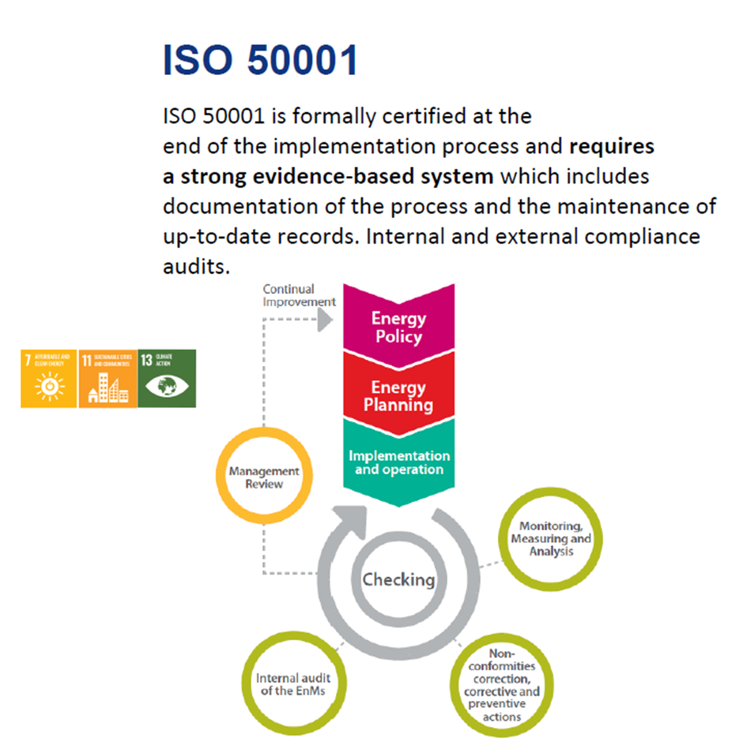
Energy Management System
Climate First Steering Committee
Energy Team
SEAI Awards
2019 Leadership in Public Sector
2021 Energy Team of the Year

Slide 3
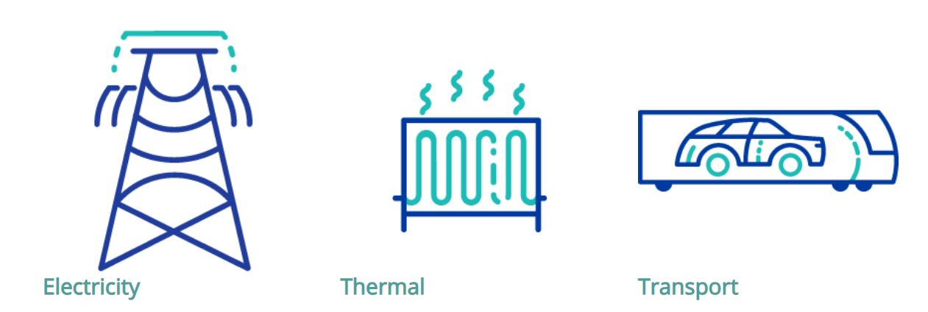
dlr Energy Use (2024)
24,500 Public Lights 120 Buildings 326 Vehicles
€4.52 million - dlr energy spend

Slide 4
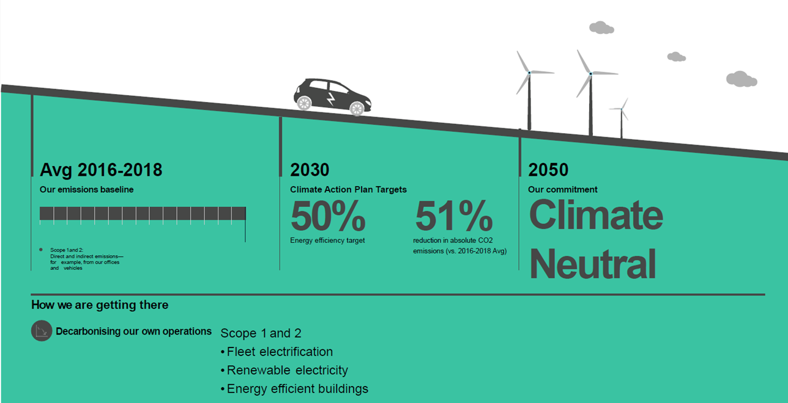
Energy Efficiency & Carbon Targets
Public Sector 2030 Target | dlr 2024 Performance | Note
50% Energy Efficiency target | 55.7% | Baseline 2009
51% carbon emissions (GHG) reduction | 51.7% | Baseline 2016-2018 average – this includes electricity
51% direct emissions reduction | 25.8% | Baseline 2016-2018 average – thermal and transport

Slide 5
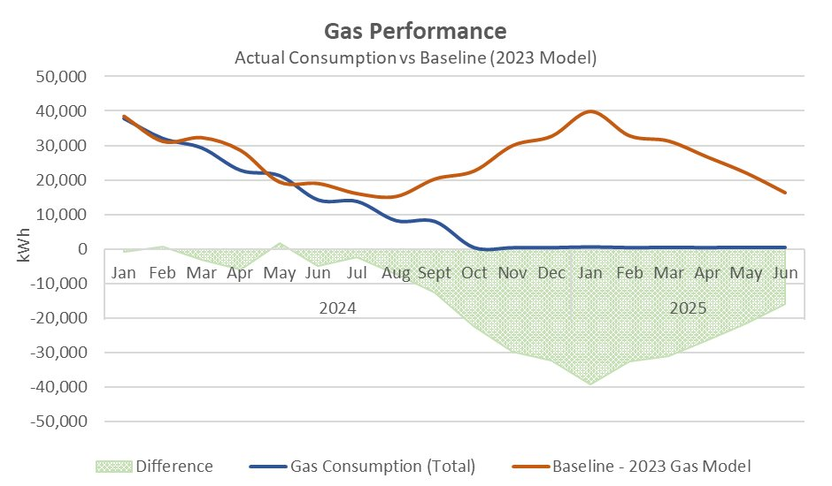
Ballyogan Operations Centre
Ballyogan Operations Centre: This site has reduced its direct emissions by over 99% through the installation of heat pumps.
Additionally, imported electricity from the grid has been substantially reduced due to 172kW solar PV installation

Slide 6
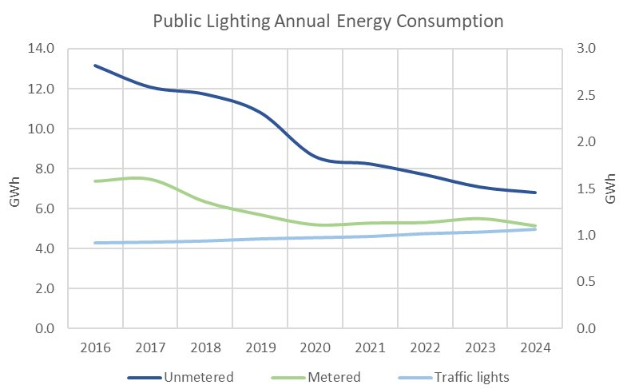
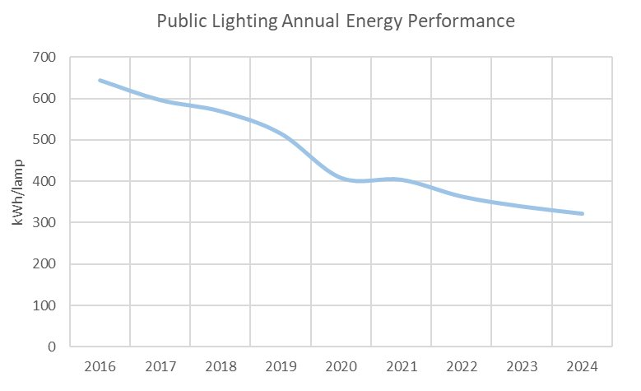
Public Lighting
Public Lighting LED Roll-out
By end 2025, dlr had converted 93.4%
of street lamps to LEDs
Solar streetlight (100% off grid) on Hyde Road, Dalkey

Slide 7
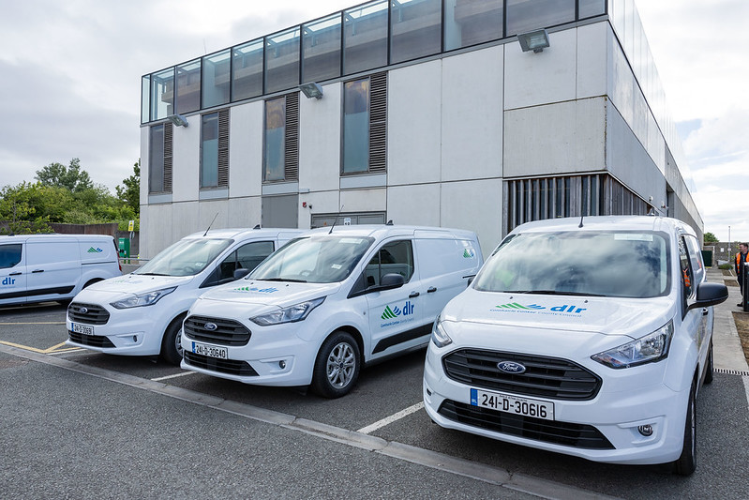
Fleet
Fleet Management
20 new H.V.O. vehicles overall total 39
6 new Electric Vehicles overall total 34
Integrated a new Telematics and Fleet Management System
New Fleet Policy adopted by Leadership Team
Developing a Fleet Transition and Funding Strategy for transitioning the fleet over the next 10 years.

Slide 8
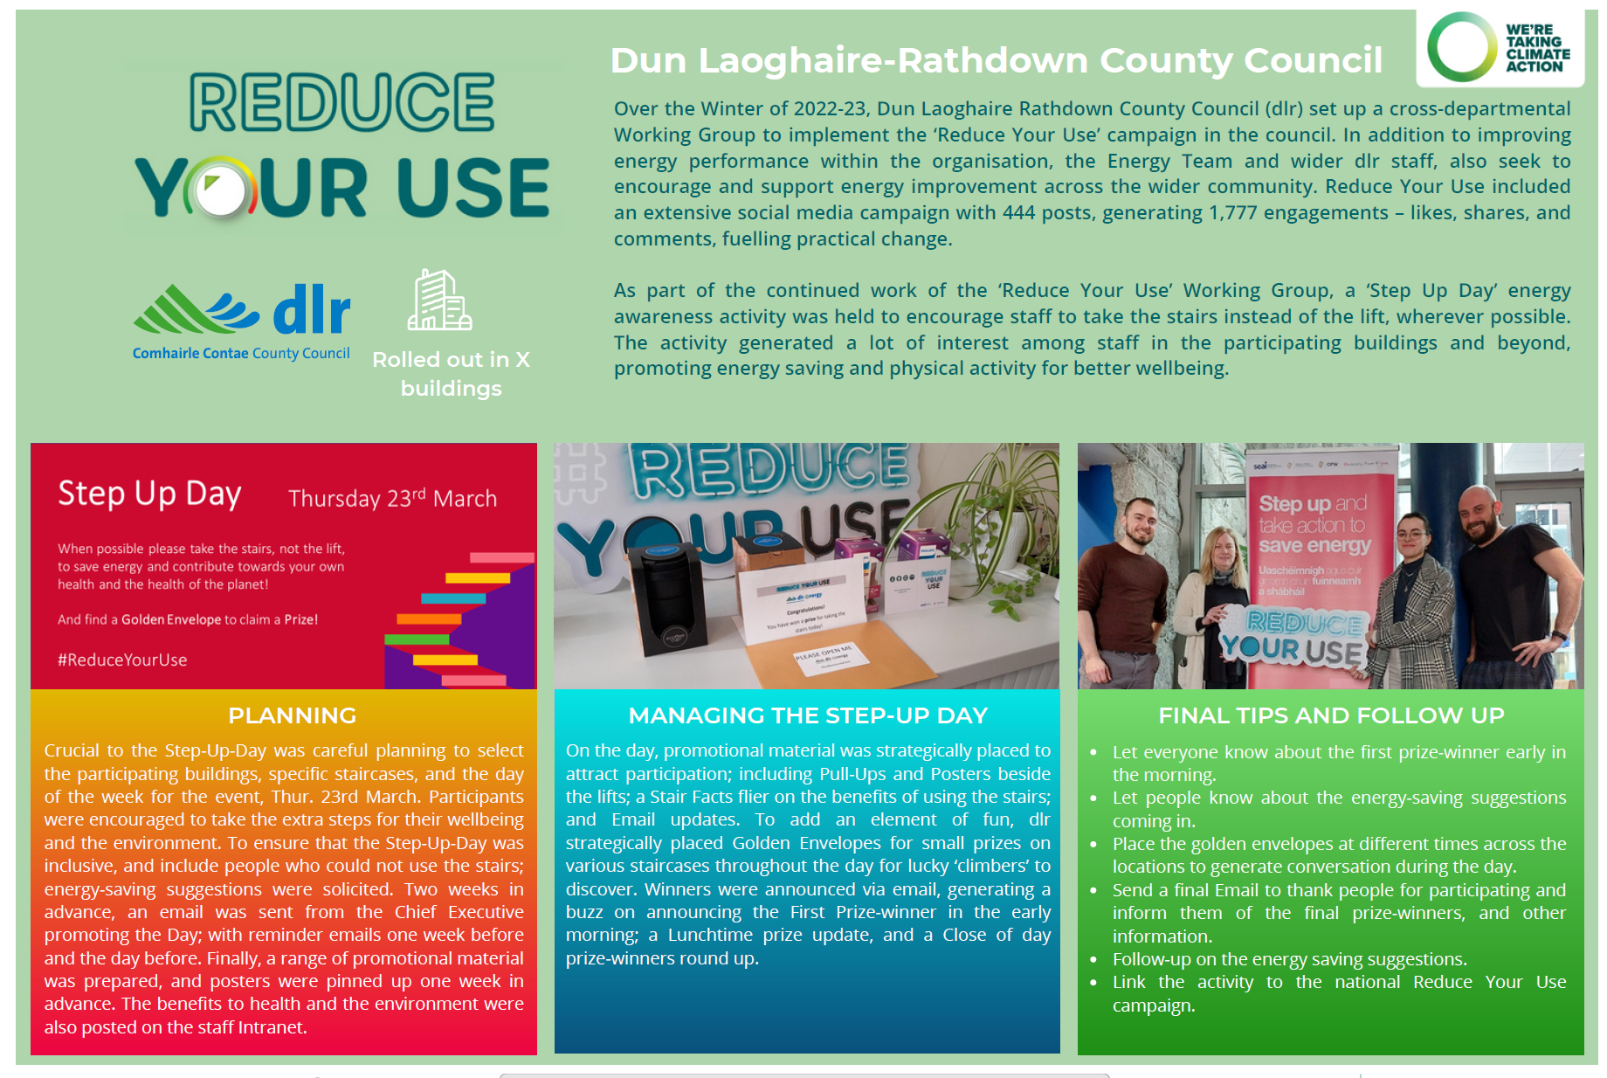


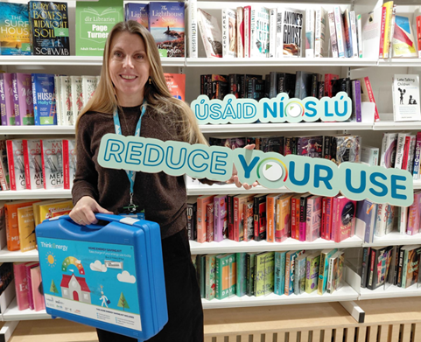

Reduce Your Use
7

Slide 9


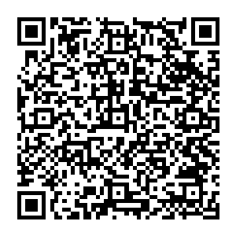
Upcoming Events
11-17 May 2026
www.dublinclimateactionweek.ie
Energy Upgrade Event
Saturday 10 October 2026
County Hall, Dún Laoghaire
Survey
8

