Slide 1














RECYCLED
DECORATION AWARDS CEREMONY

Slide 2
RECYCLED
DECORATION AWARDS CEREMONY
Housekeeping
Fire Exits Locations​
Evacuation Procedure​
Bathrooms
Phones to silent

Slide 3
RECYCLED
DECORATION AWARDS CEREMONY
The Competition:
Dún Laoghaire-Rathdown would like to congratulate all entrants and School Champions!​
Everyone here is a winner!
​When your name is called please come forward to receive your prize

Slide 4
RECYCLED
DECORATION AWARDS CEREMONY
Highly Commended
Awards

Slide 5




Recycled Christmas Snow globe
Jess foley
St. Gerards Junior School
6TH CLASS

Slide 6
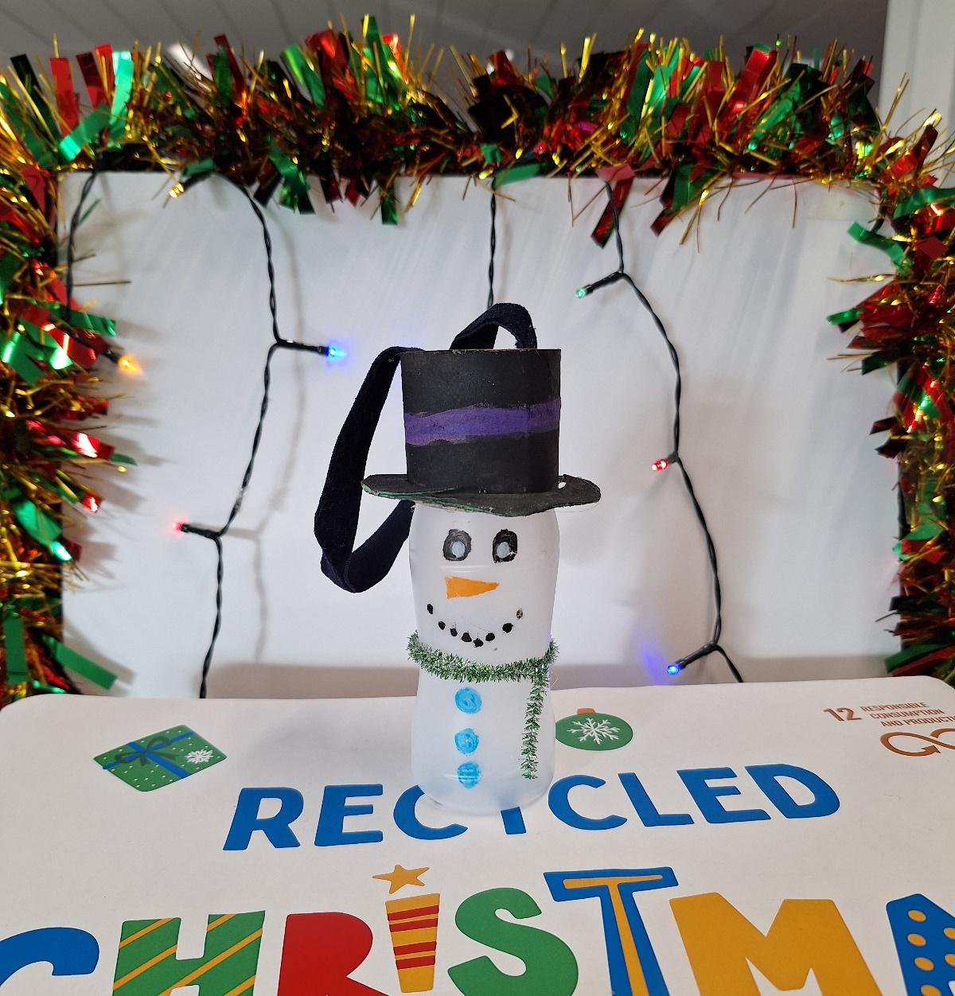
Lucy Moran
Our Lady of Mercy Convent School
1st CLASS

Slide 7
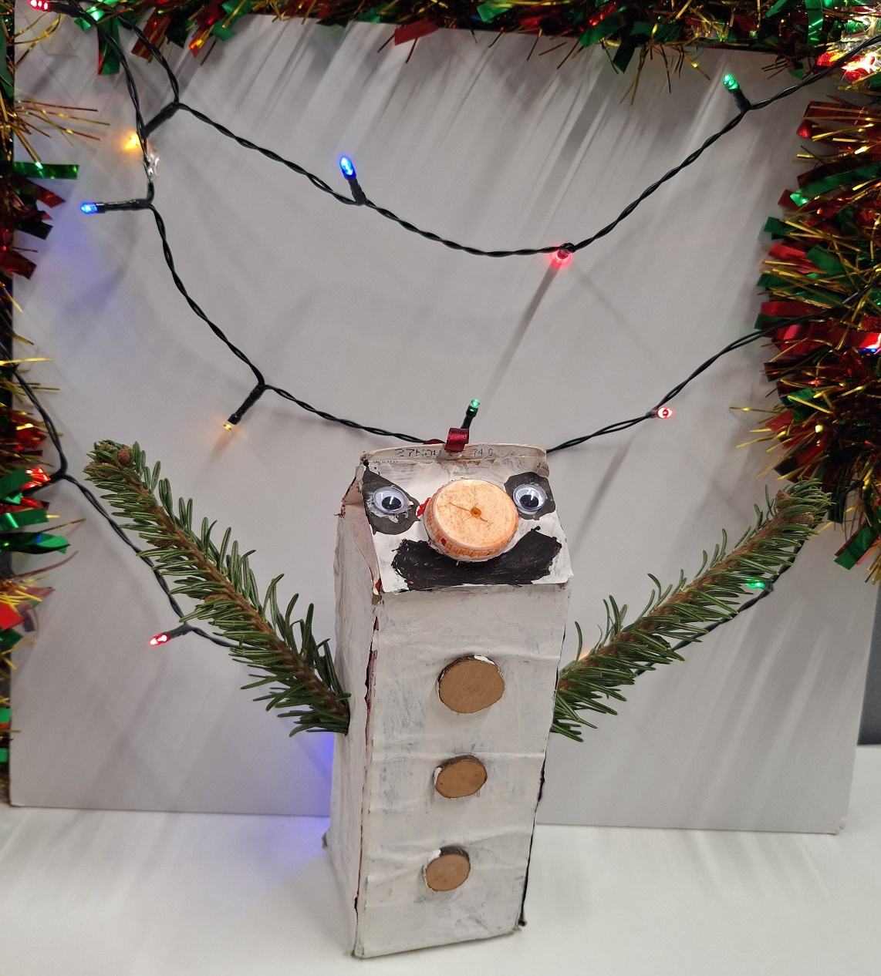
Devin Mc Garry
Oliver Plunkett National School
6TH CLASS

Slide 8
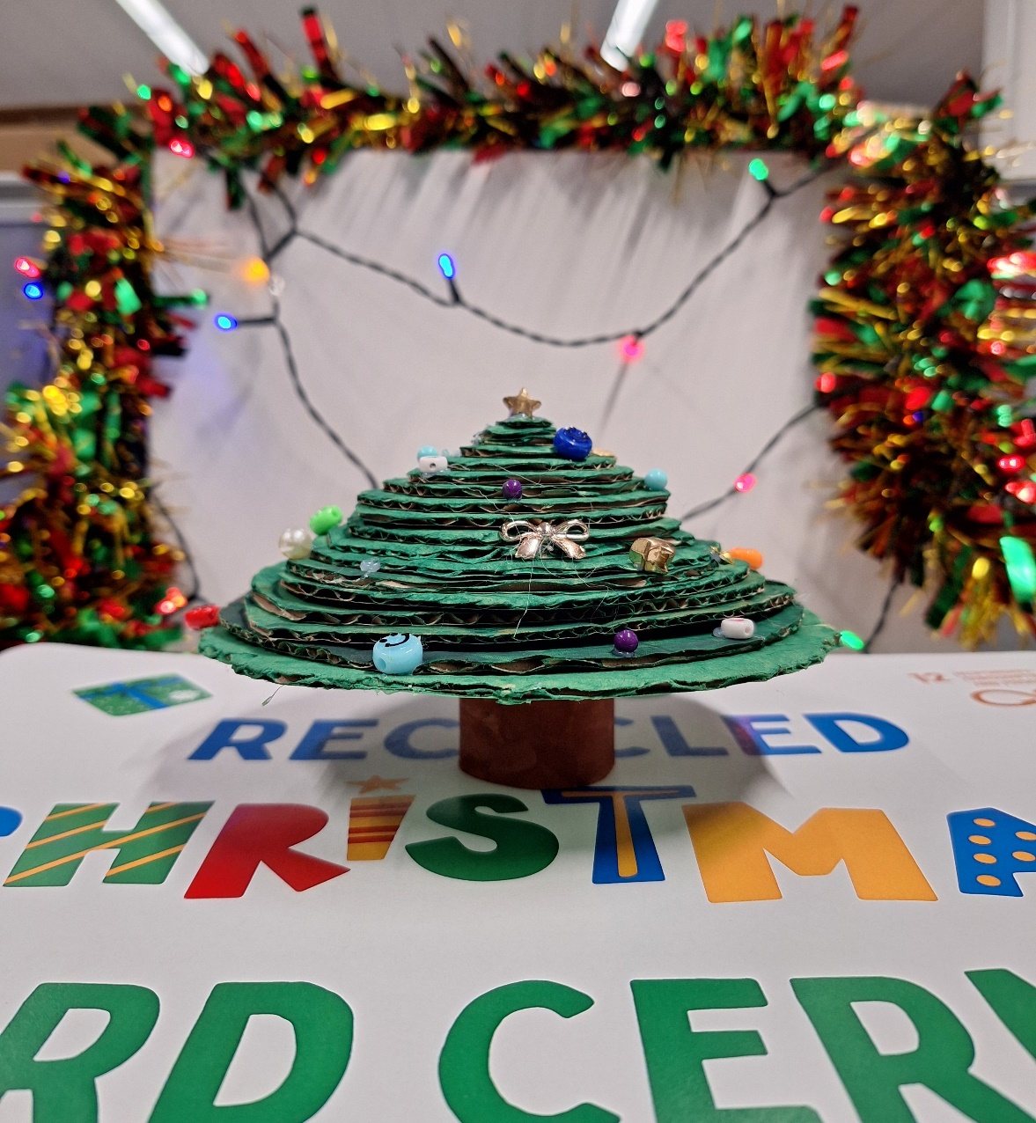
Vanessa Morrocco
St. Mary’s National School
6TH CLASS

Slide 9
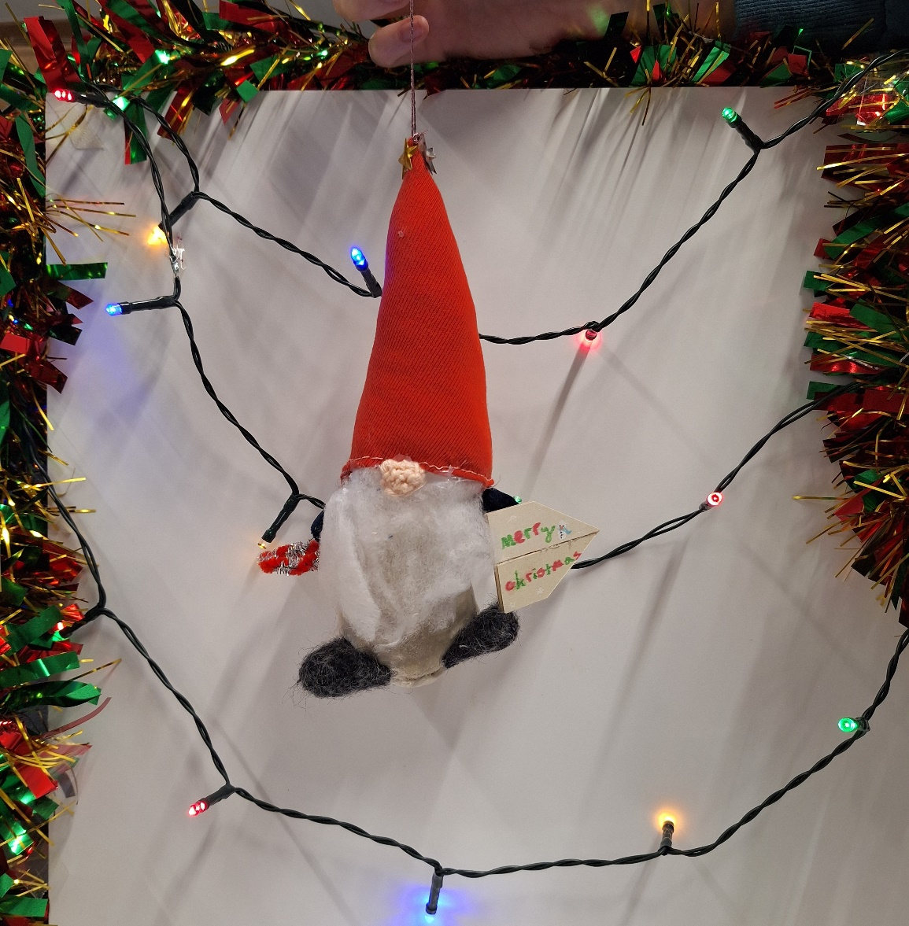
Lisa Marshall
Children’s House Primary
5TH CLASS

Slide 10
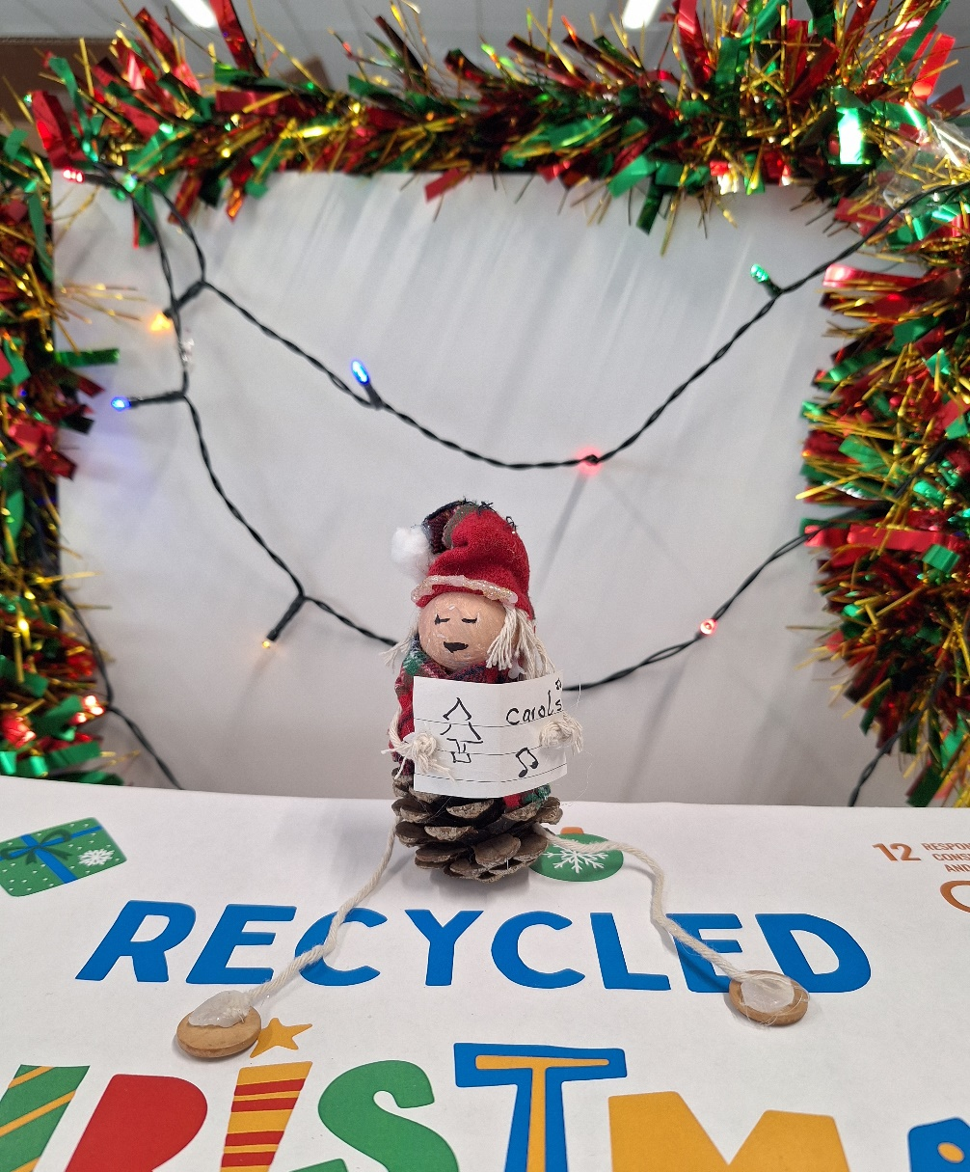
Esmé Carroll-Reddy
St. Olaf’s National School
Senior Infants

Slide 11
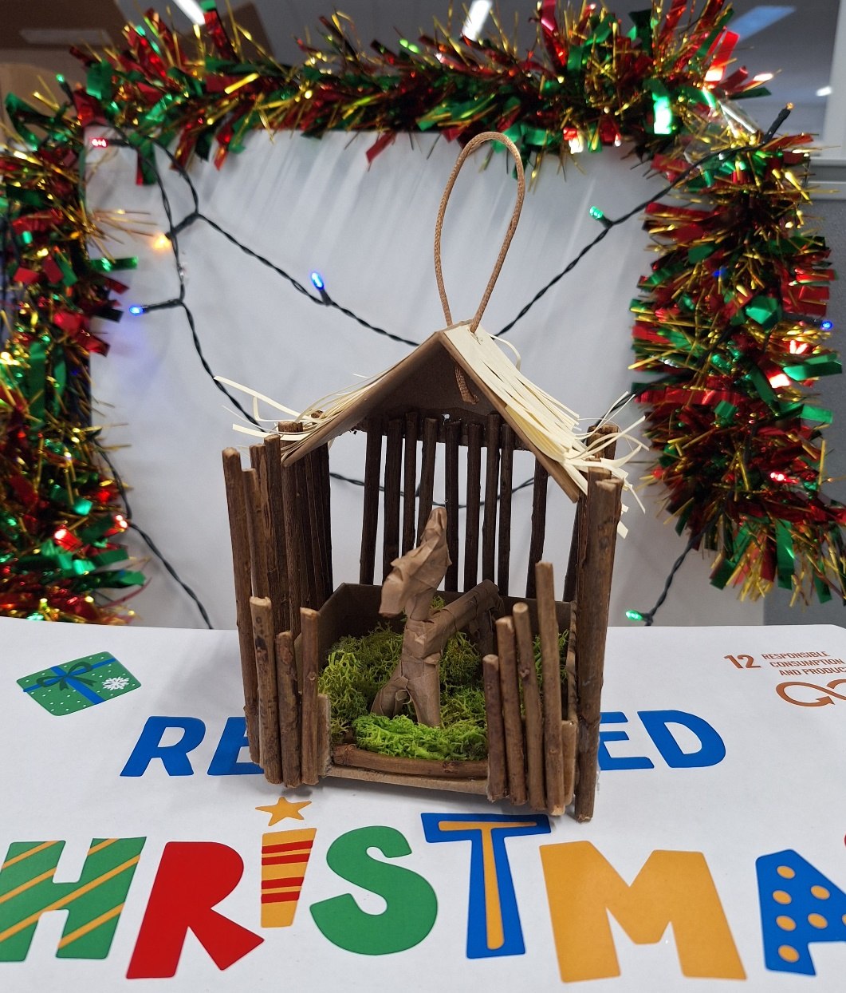
Muireann Dean
St. Brigid’s Girls National School 5TH CLASS

Slide 12
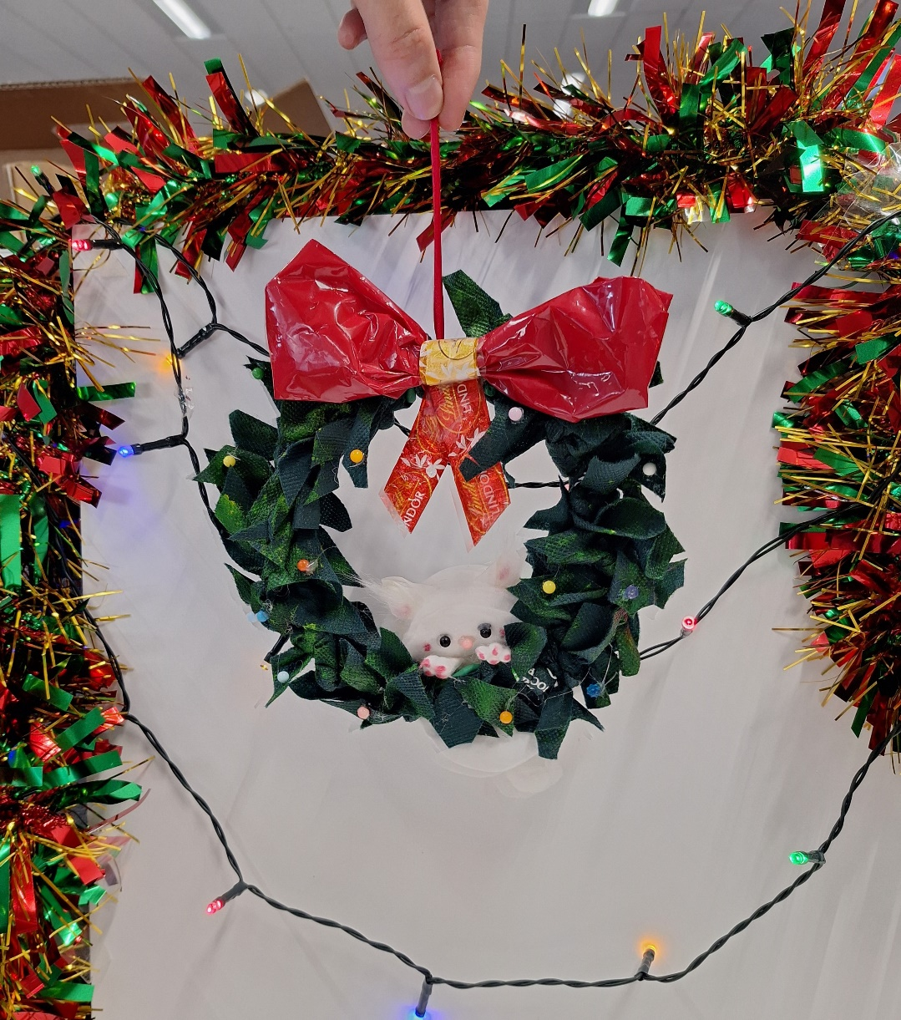
Rose O'Malley
Our Lady's Grove Primary School
5TH CLASS

Slide 13
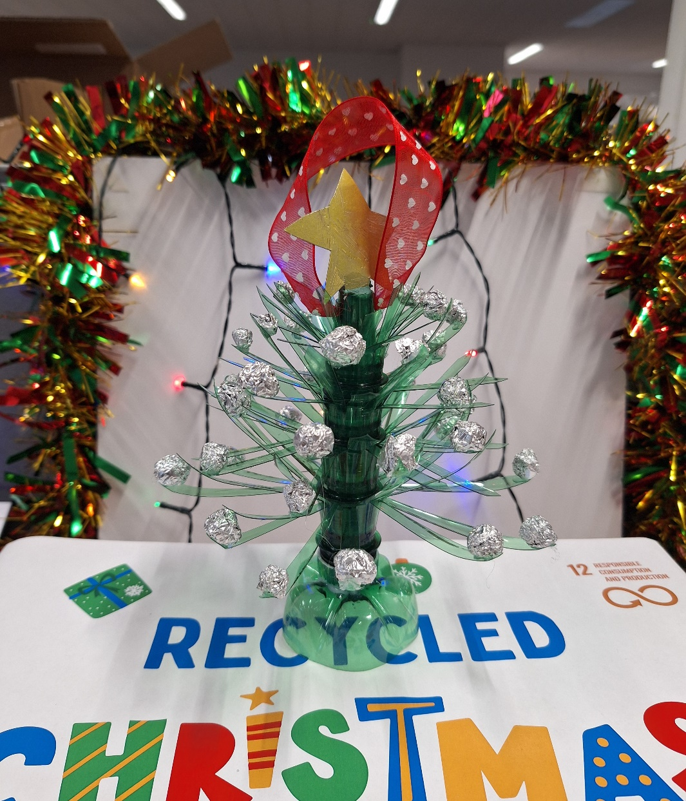
Amelia White
Loreto P.S Dalkey
6TH CLASS

Slide 14
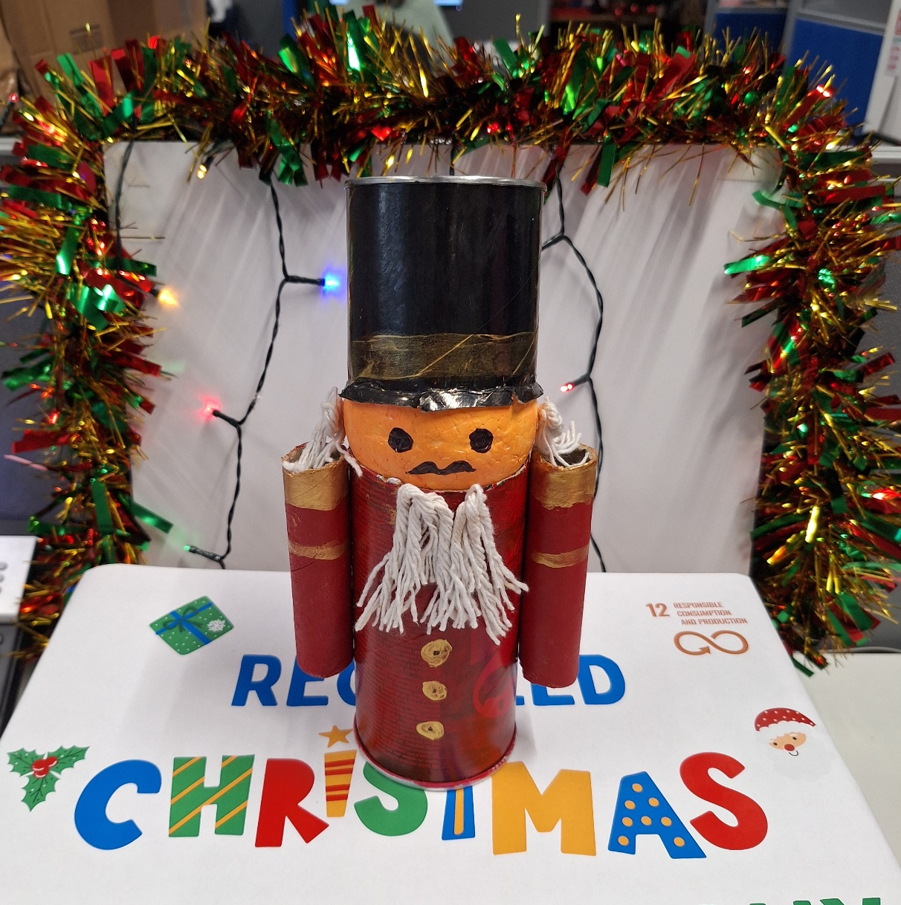
Aadhavan Venkatraman
St. Brigids Boys national school
5TH CLASS

Slide 15
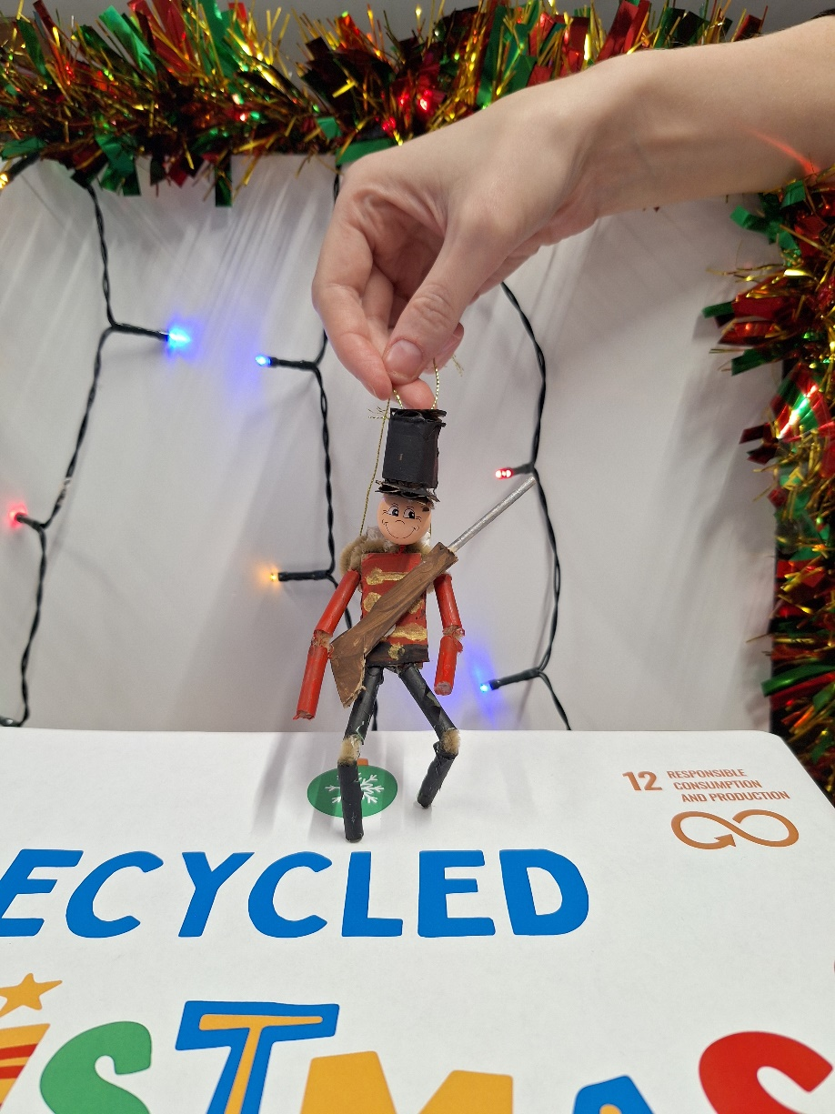
Oisín Healy
Castle Park School
6TH CLASS

Slide 16
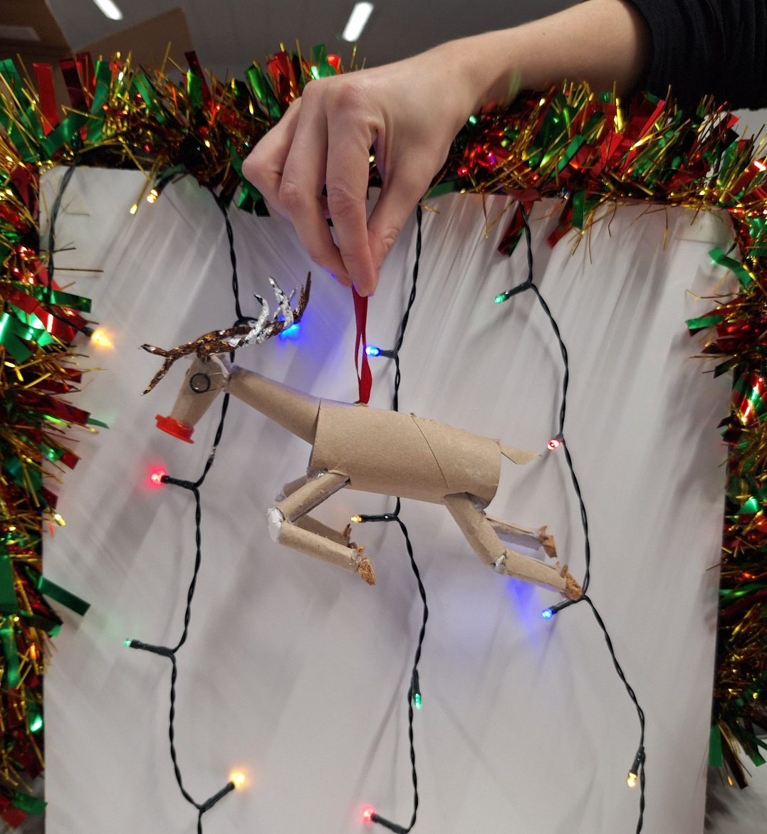
Hugh O'Hanlon
Queen of Angel’s Primary School
2nd CLASS

Slide 17
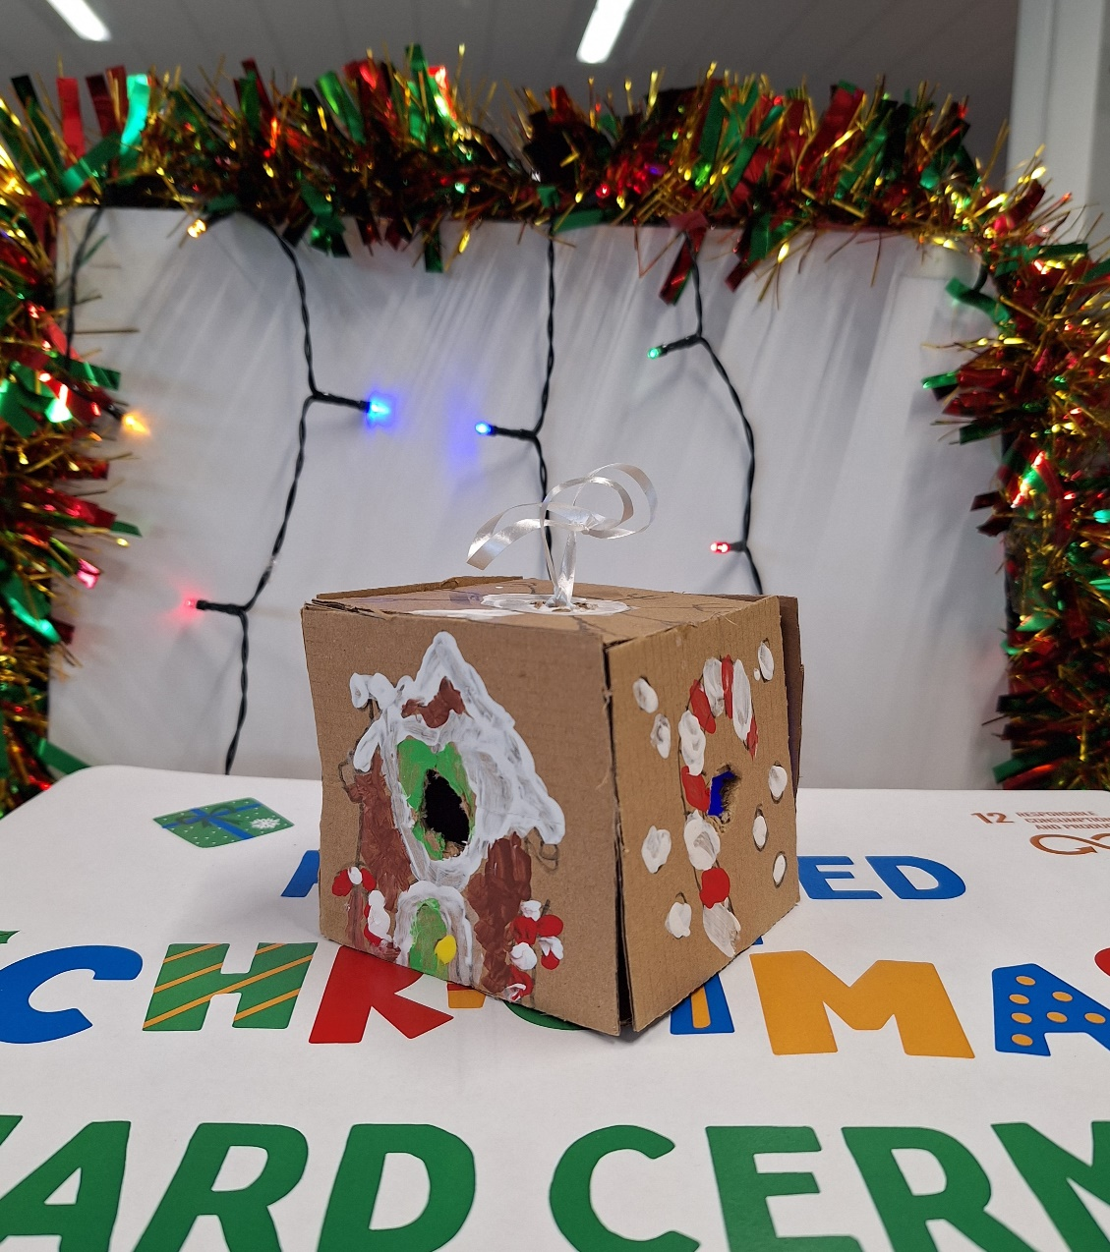
Tomek Podraza
Sharavogue Junior School
1st CLASS

Slide 18
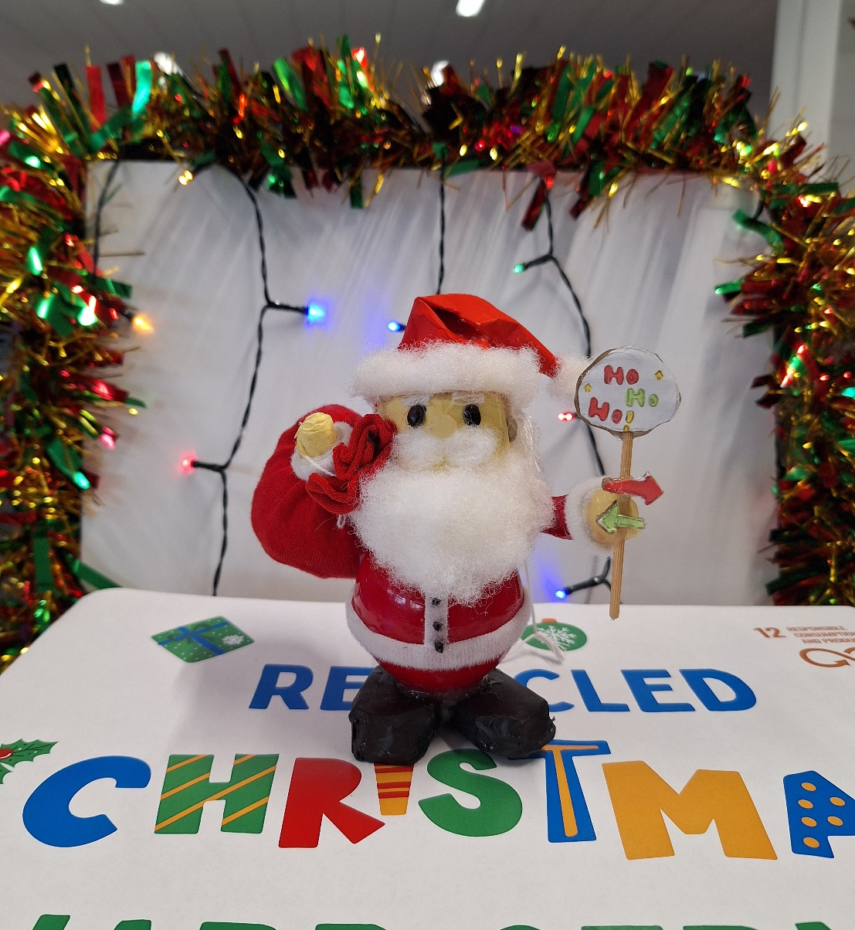
Ivy Xu
Mount Anville Primary School
3rd CLASS

Slide 19
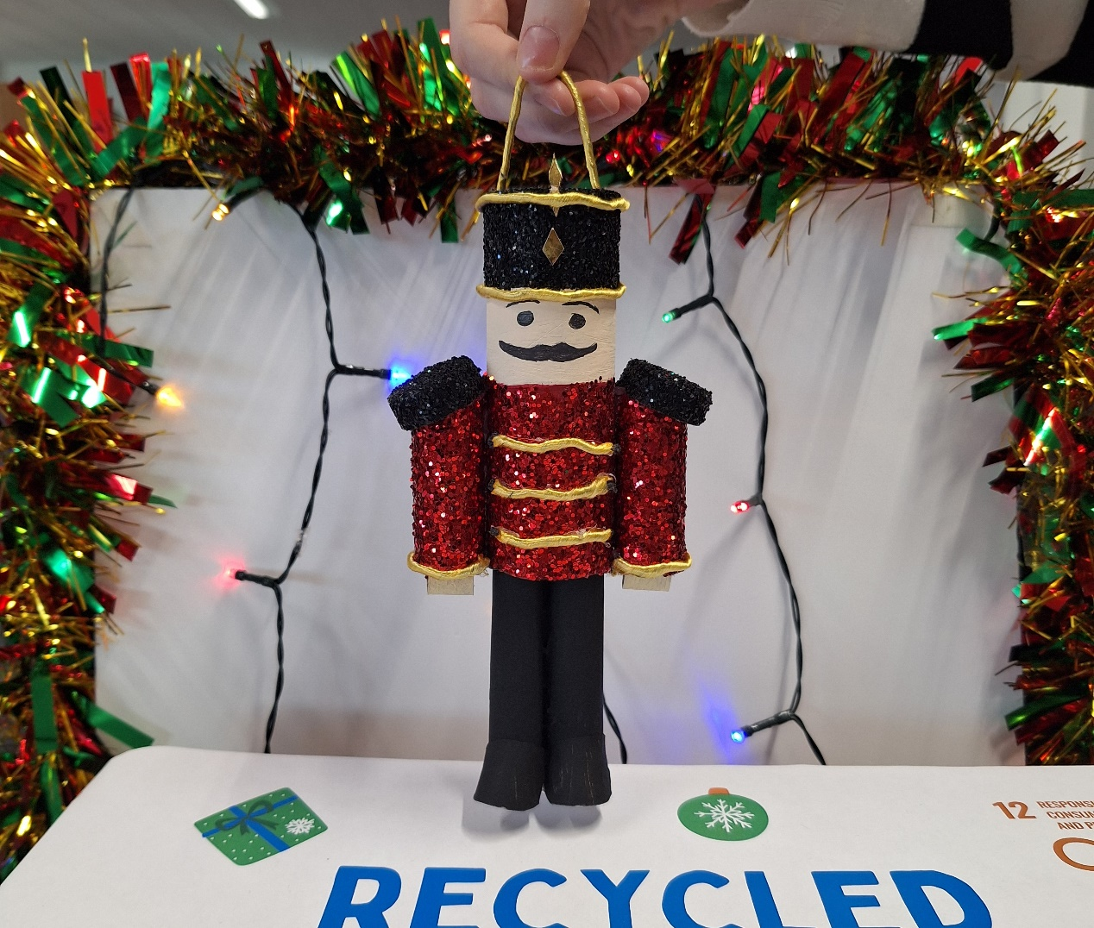
Jayden O'Neill
Divine Word National School
5TH CLASS

Slide 20
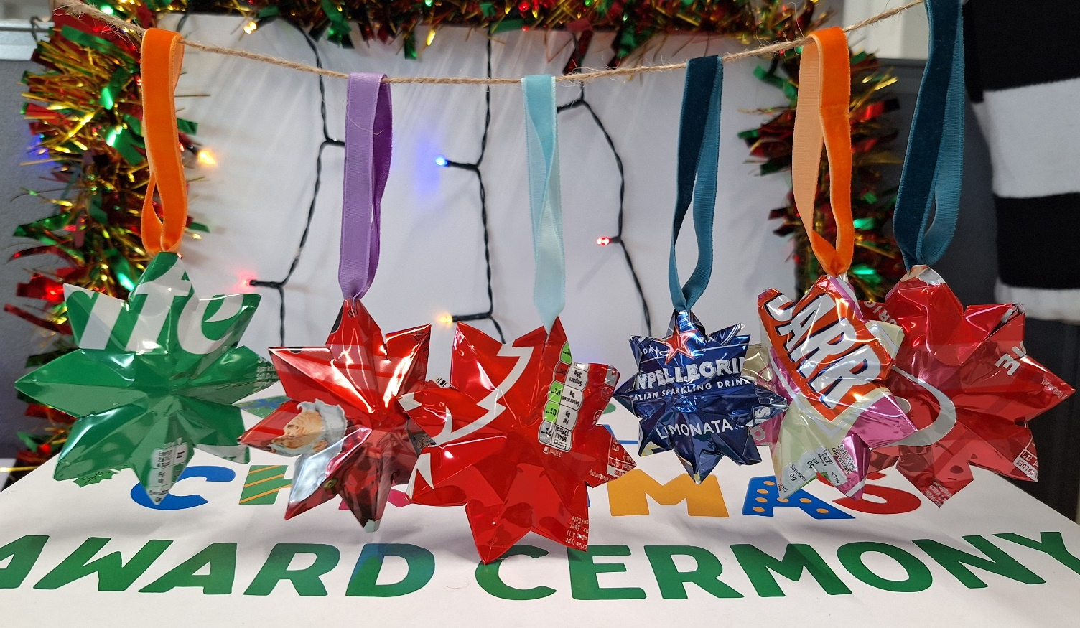
Fionn O'Brien
St Andrew's College Junior School
6TH CLASS

Slide 21
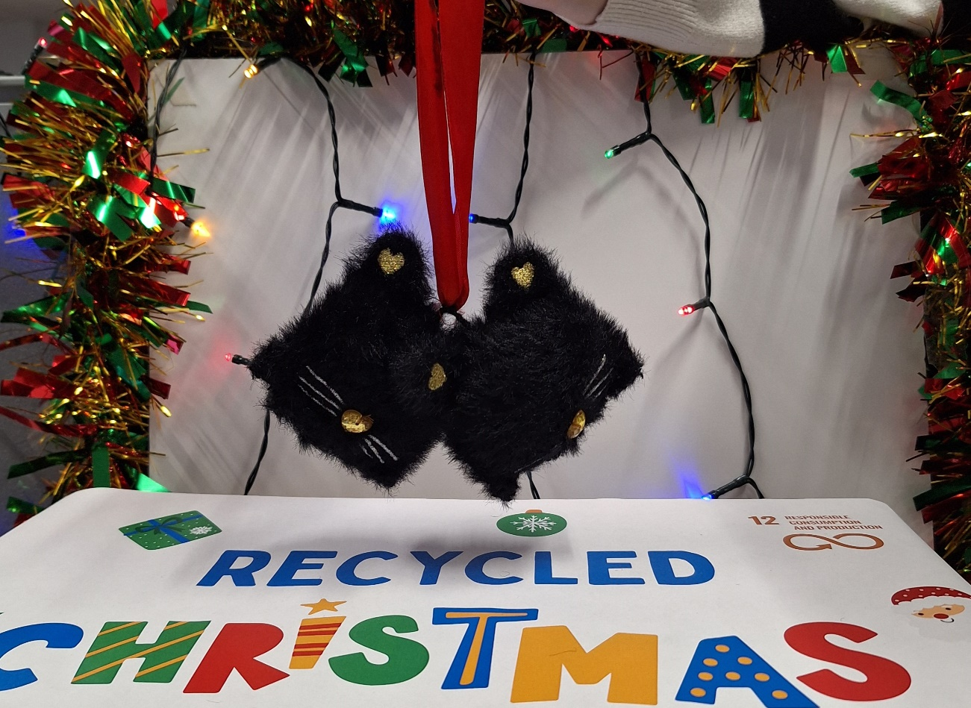
Lucybelle Hedderman
St. Anne's National School
5TH CLASS

Slide 22
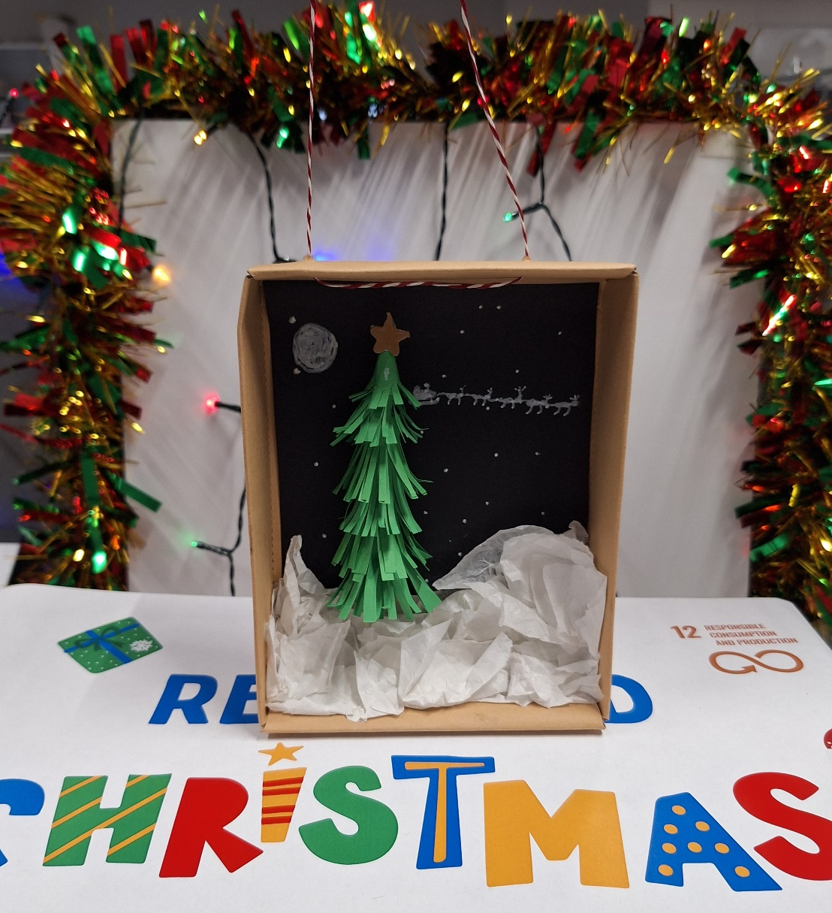
Dylan Smyth
St Mary’s Boys National School
5TH CLASS

Slide 23
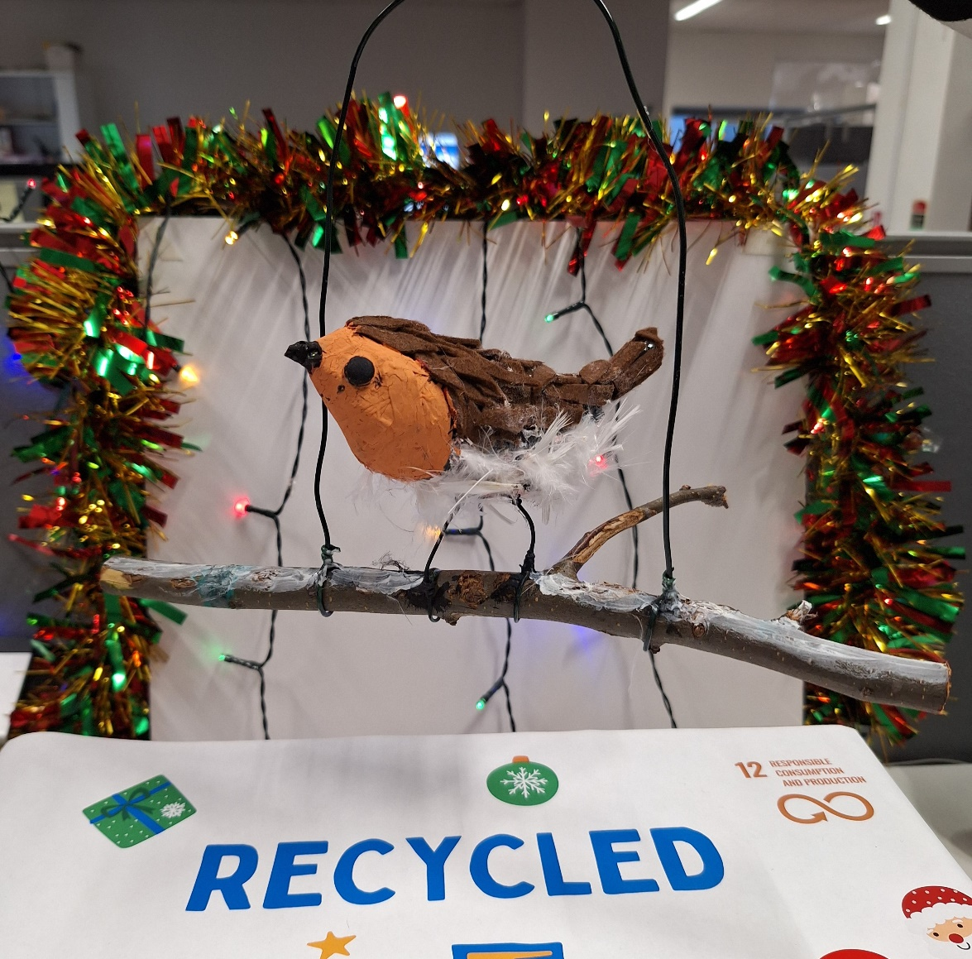
Cara Kilroy
Rathfarnham Educate Together NS
2nd CLASS

Slide 24
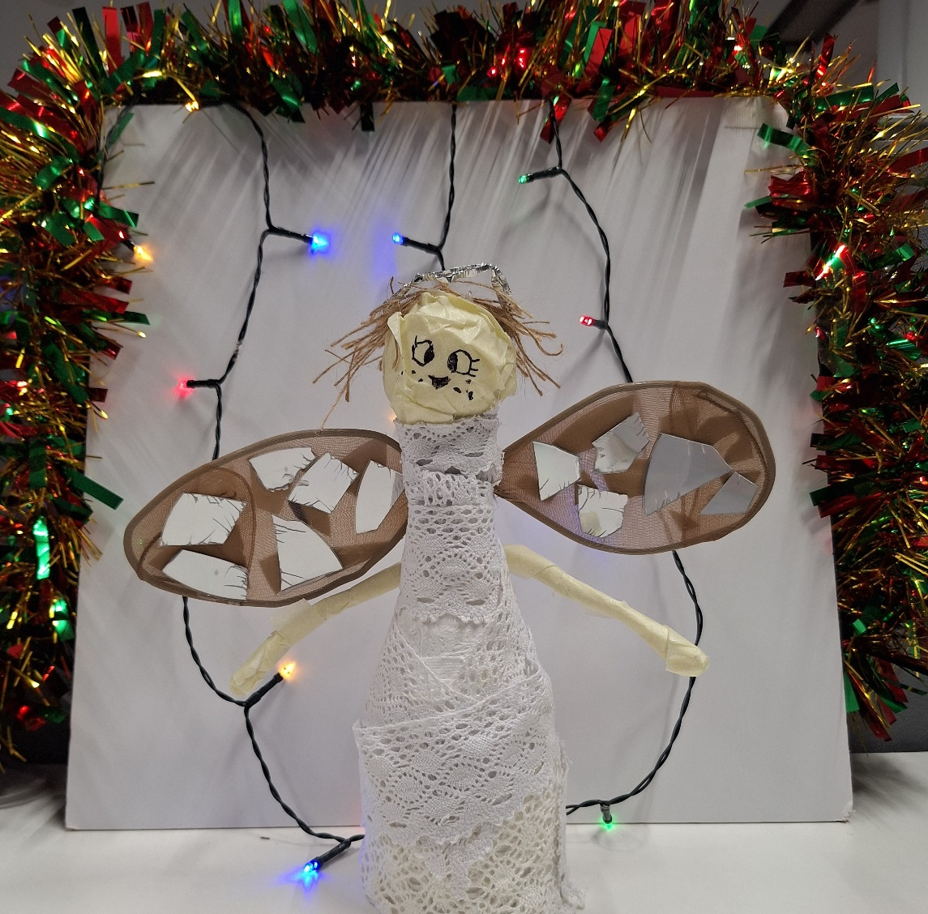
Oscar Quill
Our Lady of Good Counsel BNS
4TH CLASS

Slide 25
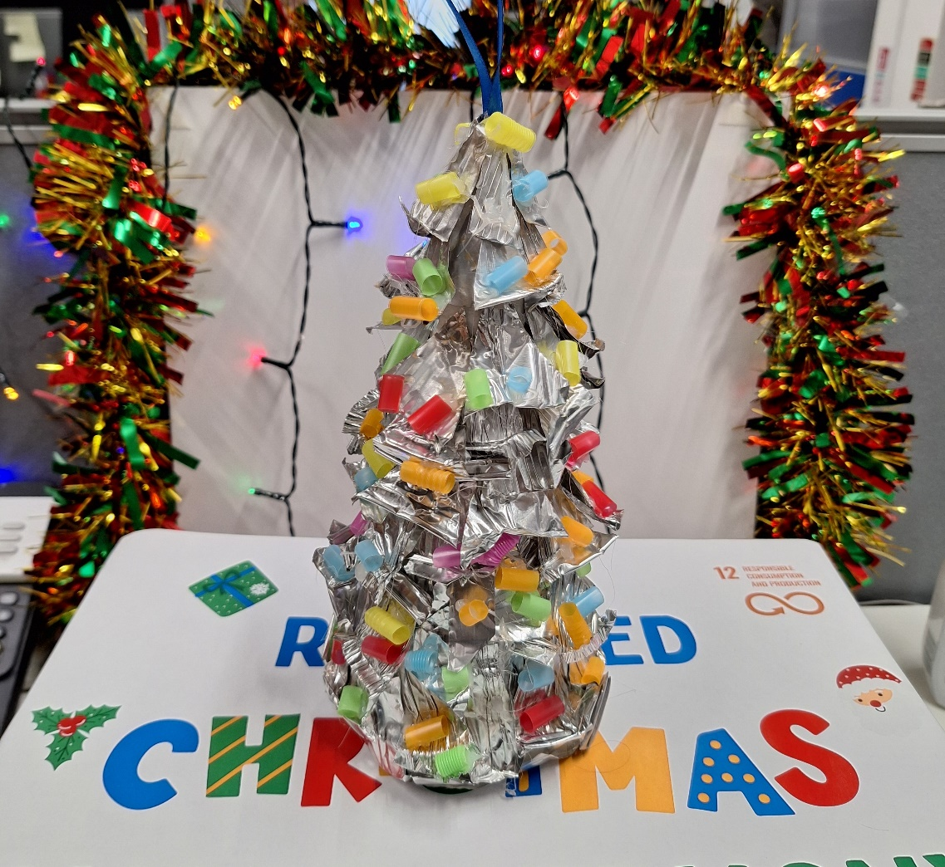
Portia McLaughlin
Our Lady of Good Counsel gNS
6TH CLASS

Slide 26
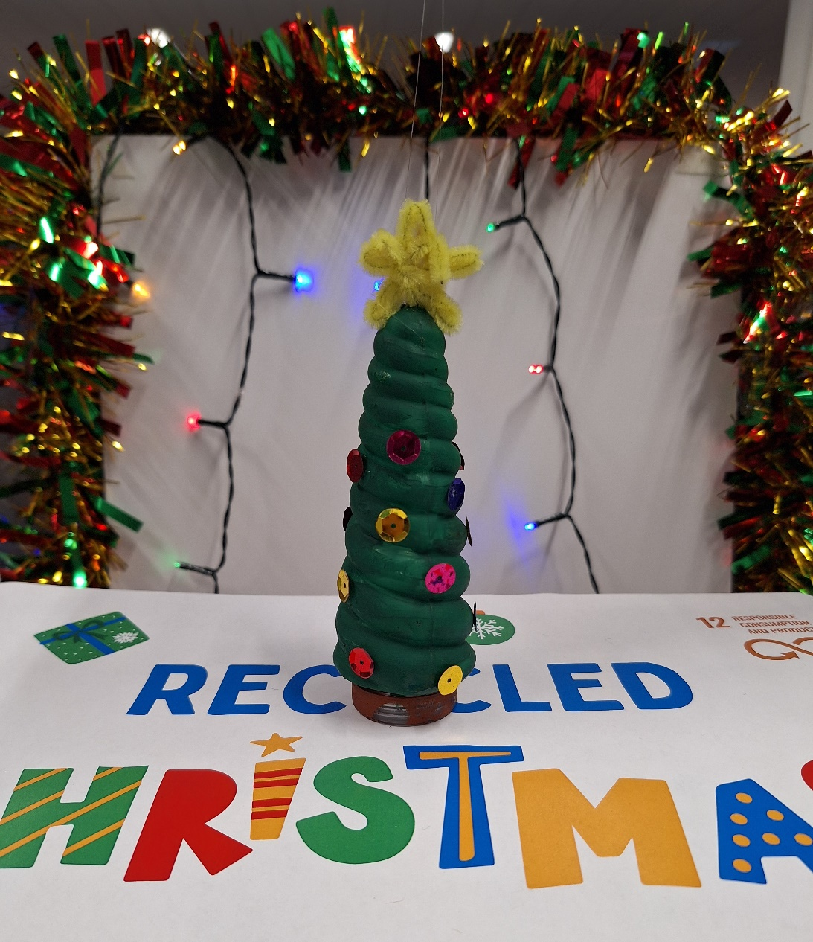
Sabina Crau
Oatlands Primary School
5TH CLASS

Slide 27
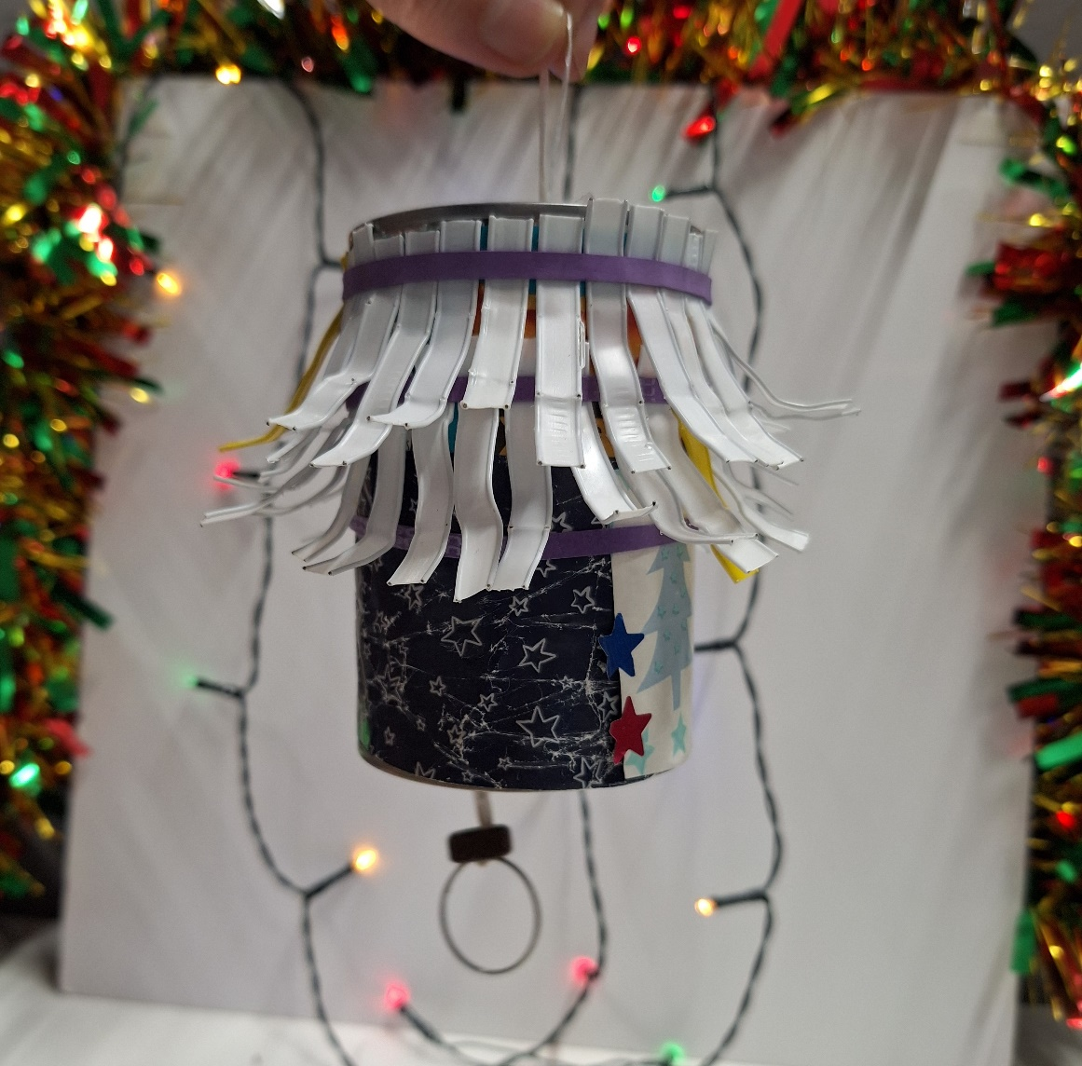
Fionn Budd
Monkstown Educate Together
3rd CLASS

Slide 28
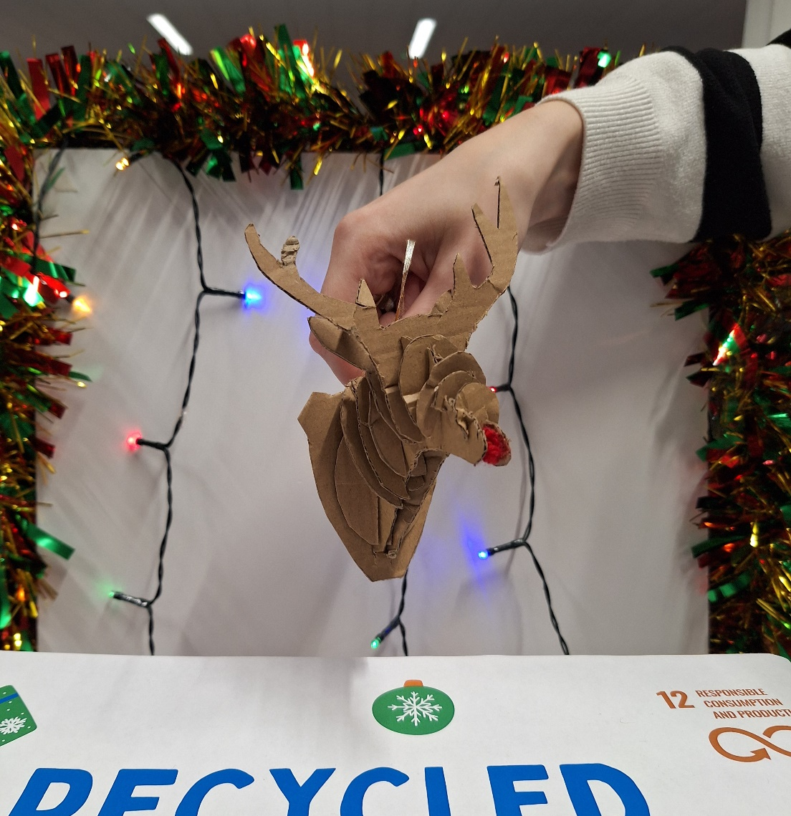
Lucy Greene
Scoil San Treasa
5TH CLASS

Slide 29
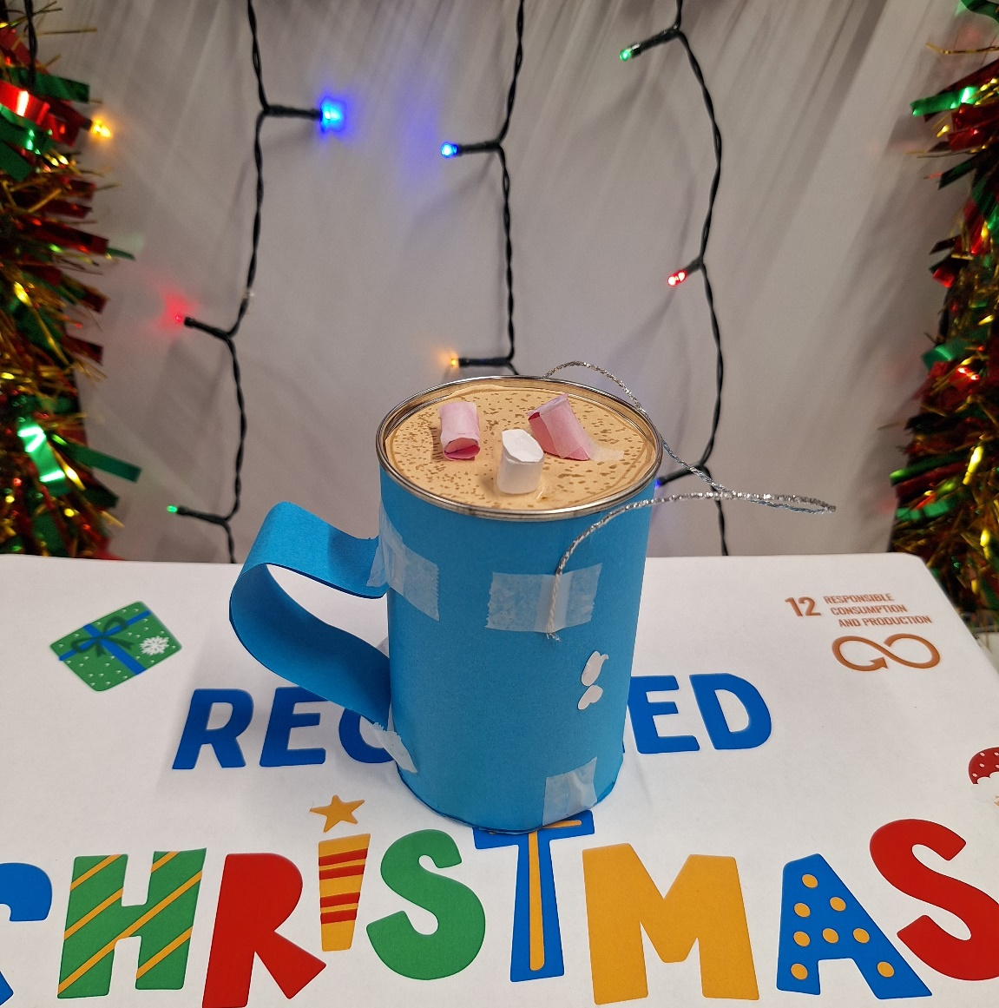
Andrew Murray
Harold Boy's National School
2nd CLASS

Slide 30
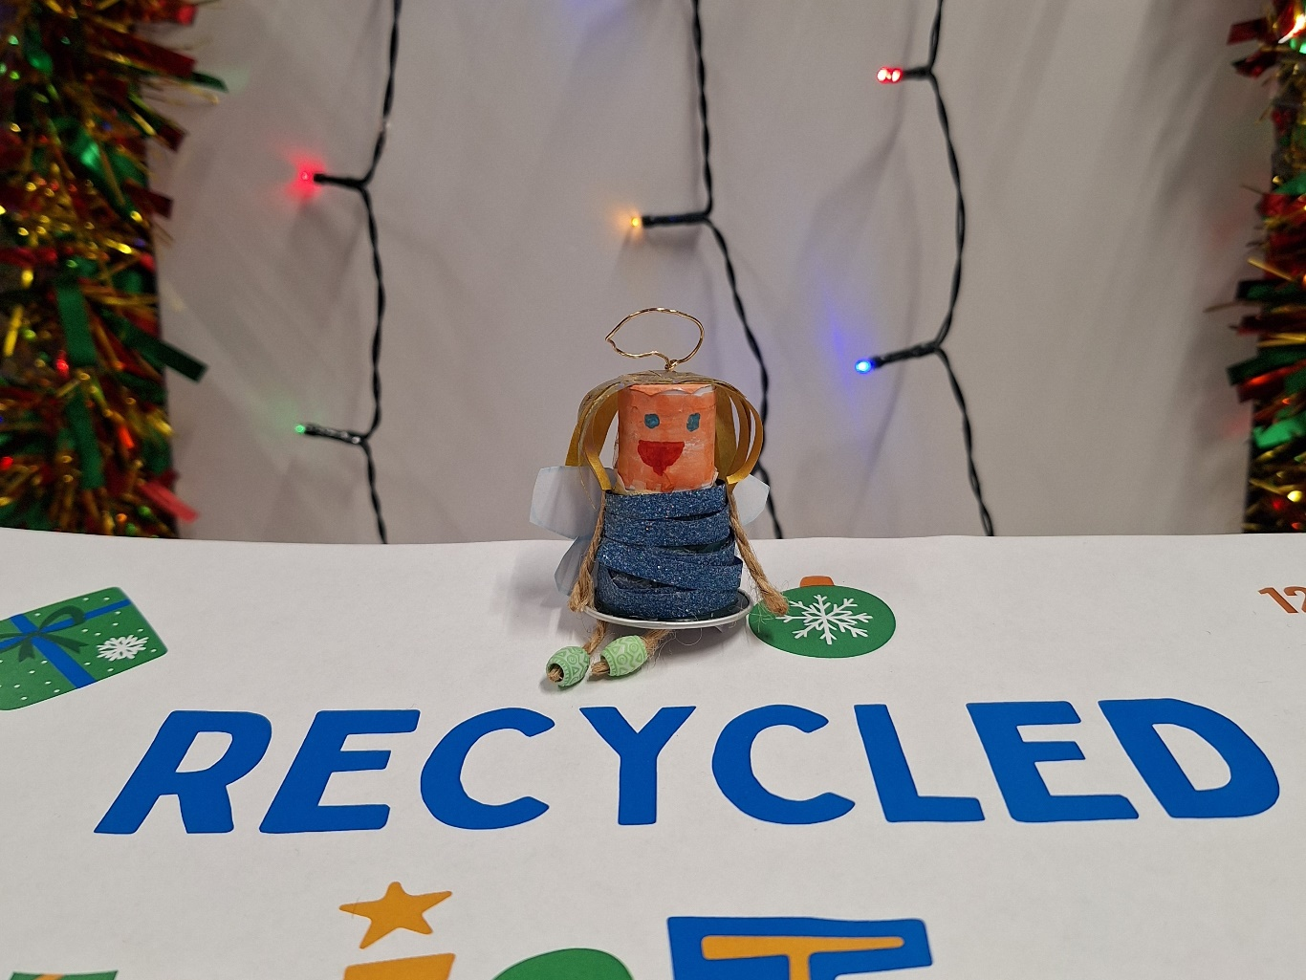
Katie Magee
The Harold School
3rd CLASS

Slide 31
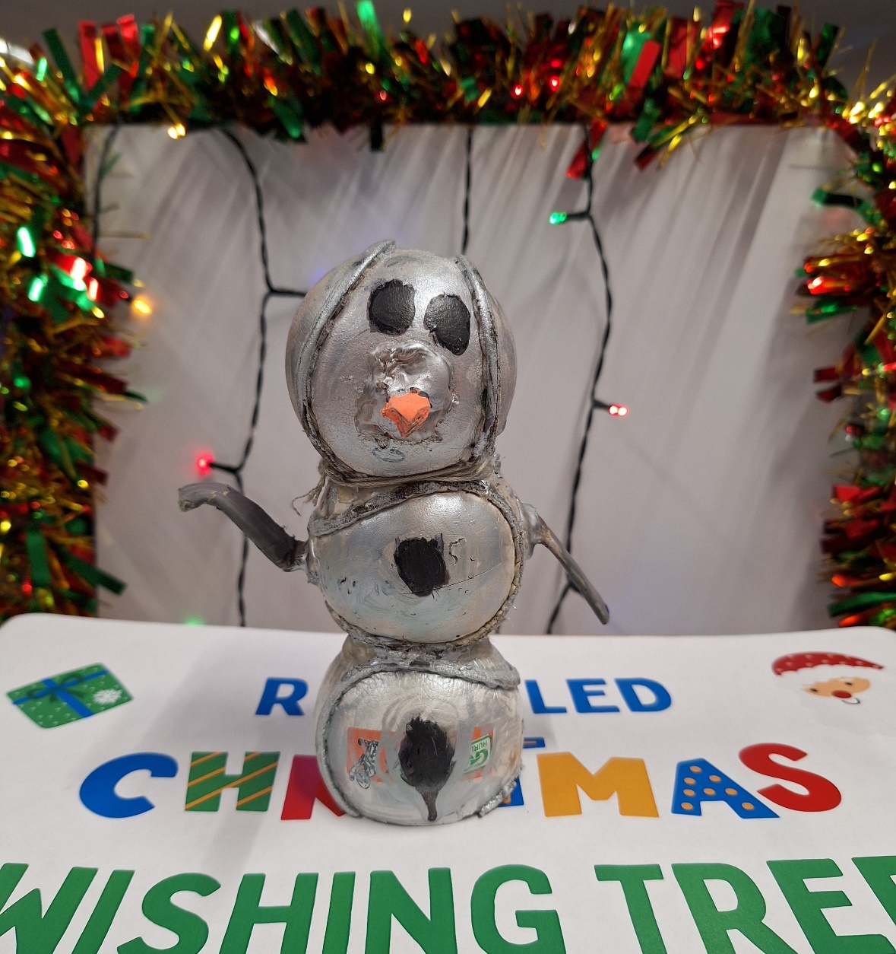
ZoË Ní Chorcráin
Scoil Naithí
2nd CLASS

Slide 32
RECYCLED
DECORATION AWARDS CEREMONY

Slide 33


Slide 34

RECYCLED
DECORATION AWARDS CEREMONY
Raffle Winner

Slide 35
RECYCLED
DECORATION AWARDS CEREMONY
Podium Places

Slide 36
Amelia White
Loreto P.S Dalkey
6TH CLASS

Slide 37
Fionn O'Brien
St Andrew's College Junior School
6TH CLASS

Slide 38
Cara Kilroy
Rathfarnham Educate Together NS
2nd CLASS

Slide 39
RECYCLED
DECORATION AWARDS CEREMONY
Thank You and Merry Christmas!
🎅🎄♻

