Slide 1
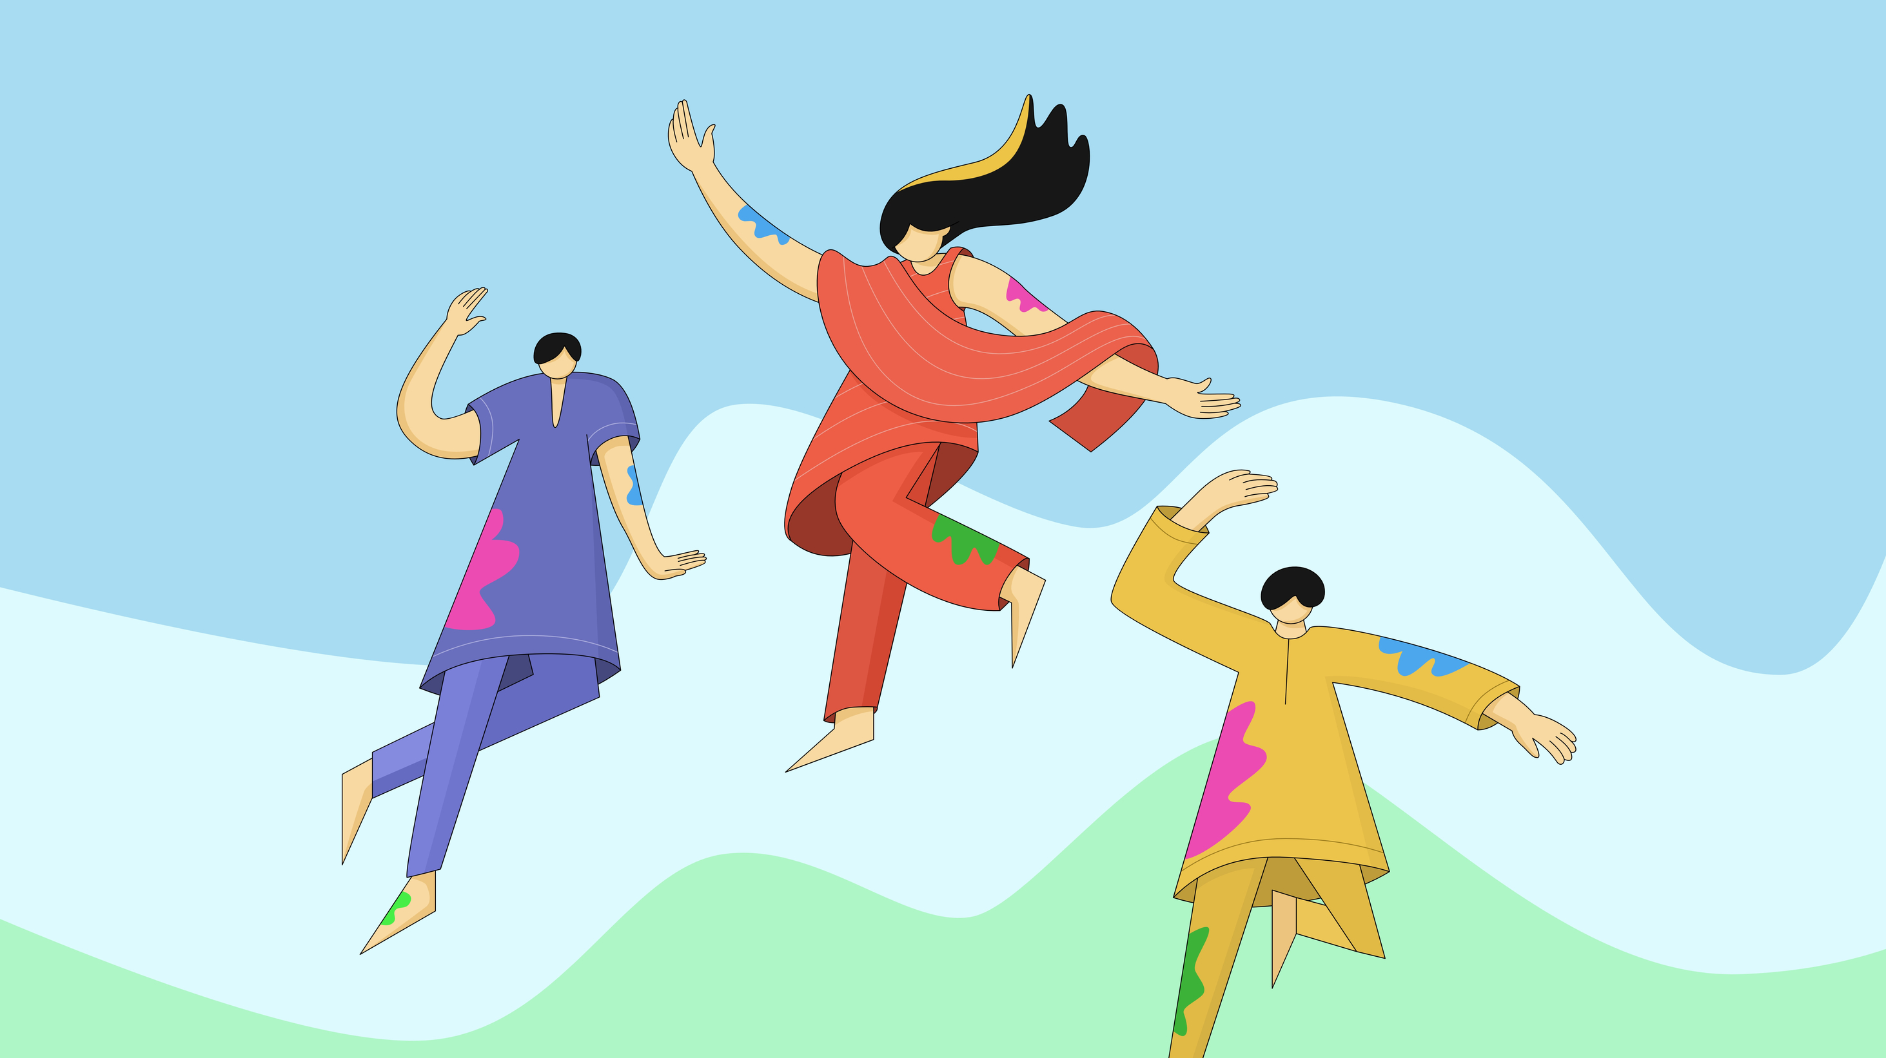
Let's Get Social - Drumming & Dancing celebrating Africa Day & Bealtaine 2025
Date: Saturday 24th May 2025
Time: 2pm -4p.m
Location: Taney Parish Hall, Taney Road, Dundrum D14 T9V0

Slide 2
Let's Get Social Drumming & Dancing celebrating Africa Day!
Date: Saturday, 24th of May, 2pm - 4pm
Time: 2pm -4p.m
Location: Taney Parish Hall, Taney Road, Dundrum D14 T9V0

Slide 3
Let's Get Social- Drumming & Dancing celebrating Africa Day!
Date: Saturday 24th May 2025
Time: 2pm -4p.m
Location: Taney Parish Hall, Taney Road, Dundrum D14 T9V0
Free of charge, all welcome - Register at Eventbrite

