Slide 1
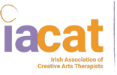
Music Therapy Róisín Hayes

Slide 2
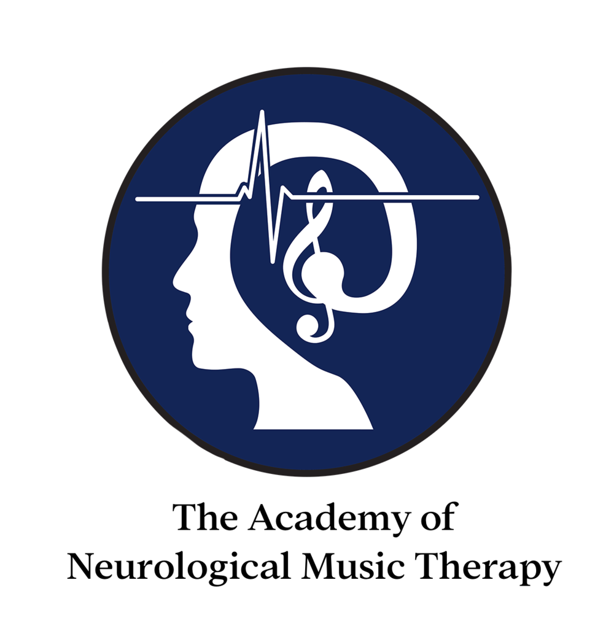
Meet Róisín (BA, MA, NMT)
IACAT registered Music Therapist.
Music, trinity college
MA Music Therapy, UL (2020)
Neurologic Music Therapist (NMT) specialist.
Play piano, flute, guitar and sing.
Roles
MT in the National Rehabilitation Hospital (NRH).
MT in St. James's hospital
CAYA Creative Arts Therapy service lead, Irish cancer Society.
Experienced healthcare assistant St. James’s Hospital.
Private work- Adults with ID, Children and adults ASD.
Placements:
Special school setting
Childrens hospice setting.

Slide 3
Music as a therapeutic tool?
‘A brain that engages in music
is changed by engaging in music.’
Brain’s normal responses
Brain’s response to music
Neuroplasticity
Regaining function
Neurologic music therapy (NMT), M.Thaut, Neuroscientist, founder of NMT

Slide 5
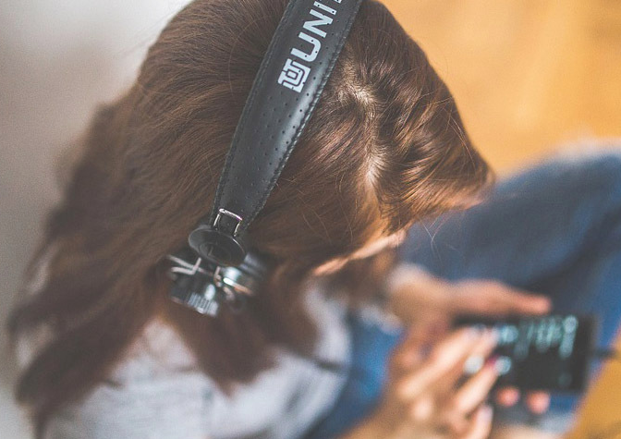
‘Music has the power to
make us smile,
bring us to all kinds of tears,
Take us back in time and
make us dance in the moment.’

Slide 6
Ballerina: https://www.youtube.com/watch?v=IT_tW3EVDK8
Henry: https://www.youtube.com/watch?v=8HLEr-zP3fc
NMT: https://www.youtube.com/watch?v=pzenDIwFllw

Slide 7
Dementia

Slide 9
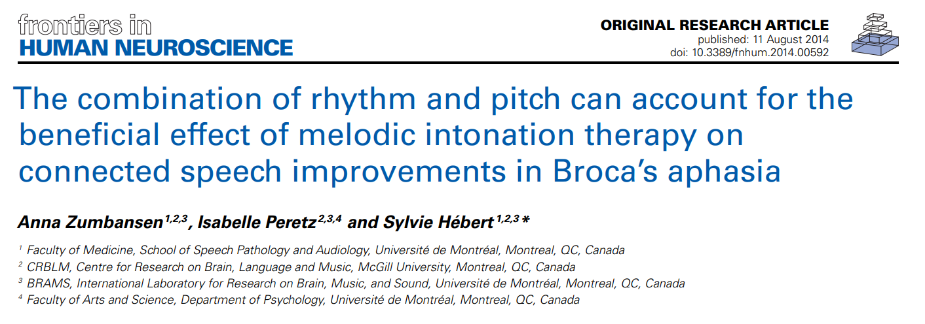
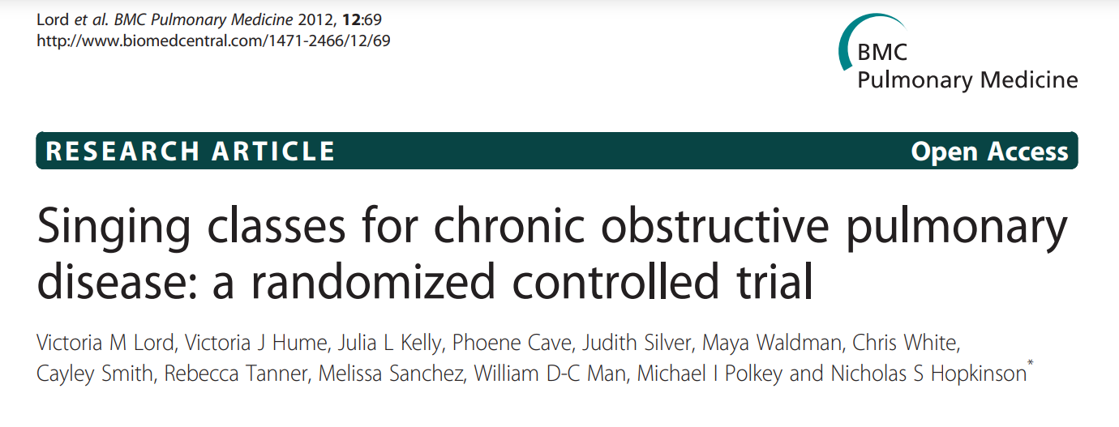
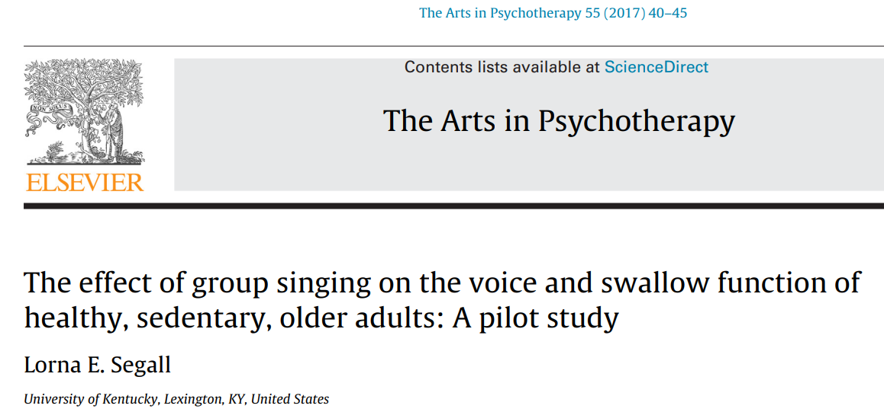
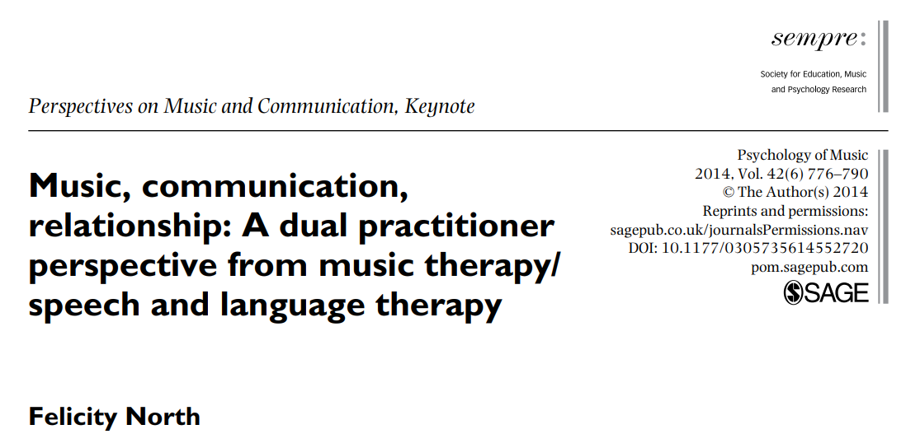
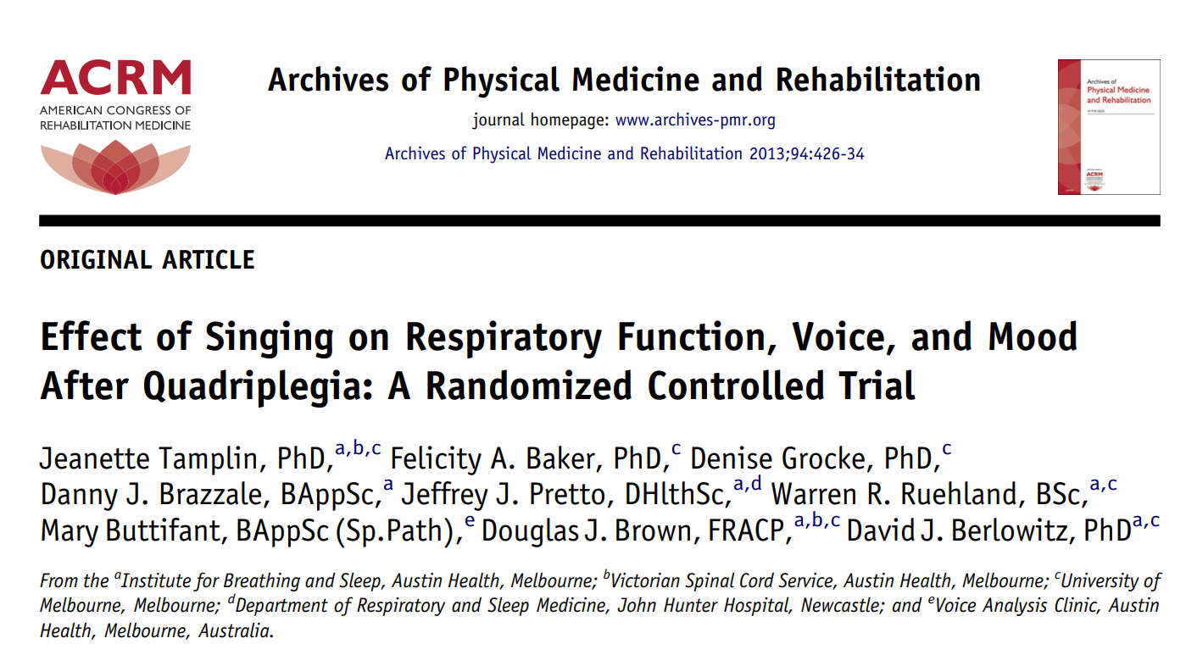
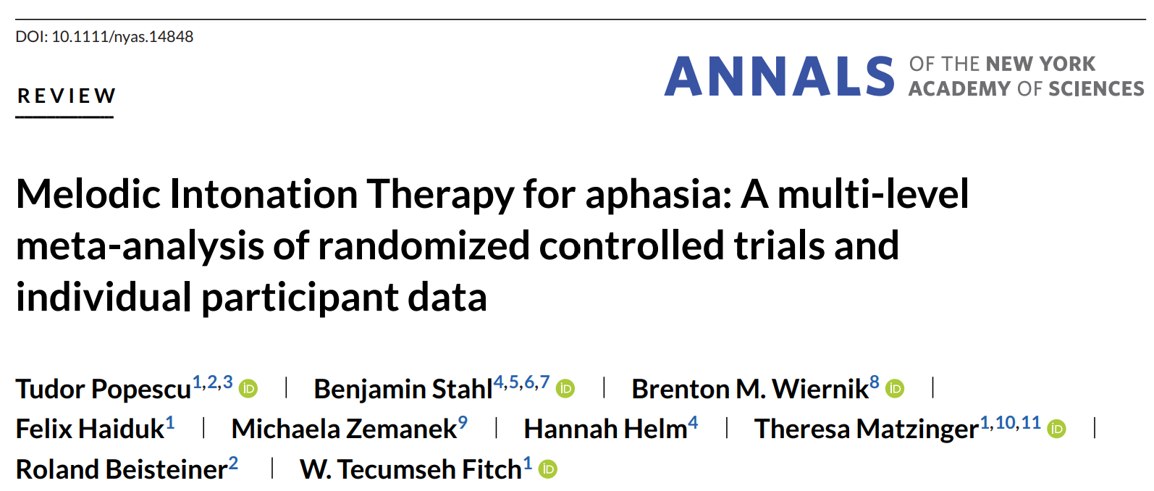

Slide 10
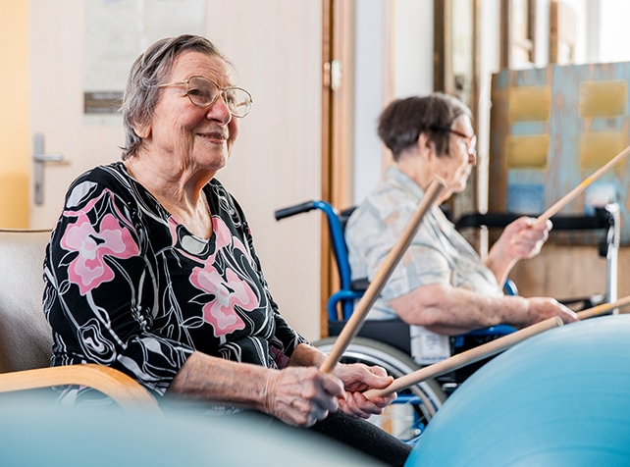
MOVEMENT
Planning and sustaining movement
Motivation and trust during PT sessions (music may enhance the experience of PT)
Elements of music (rhythm, pitch, melodies) in targeting motor support. (eg. Rhythmic Auditory Stimulation)
Using musical instruments during PT sessions (Therapeutic Instrumental musical performance (TIMP)).
Reduction in Ataxic movement.
Stride length, balance, cadence.
Tollerating sitting/standing.
Movement for expression.
‘RAS has been found to be highly effective in gait training for stroke patients and for those with Parkinson’s disease’ (Kobinata et. Al. 2016).

Slide 11
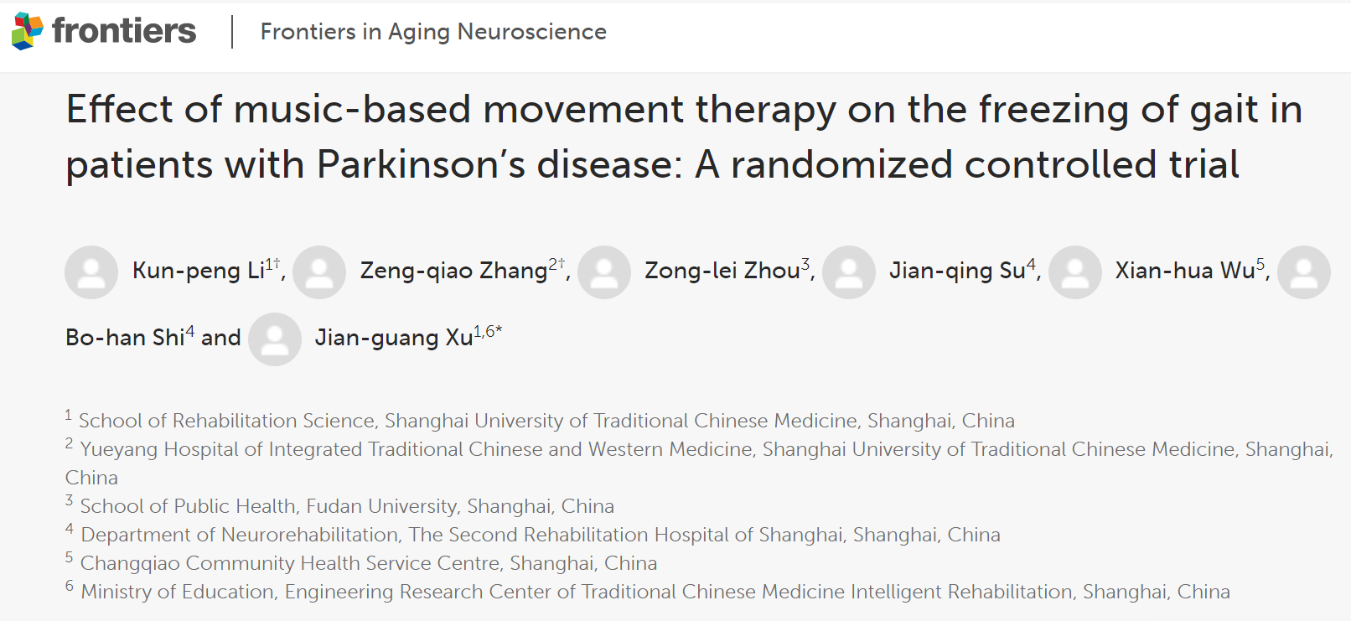
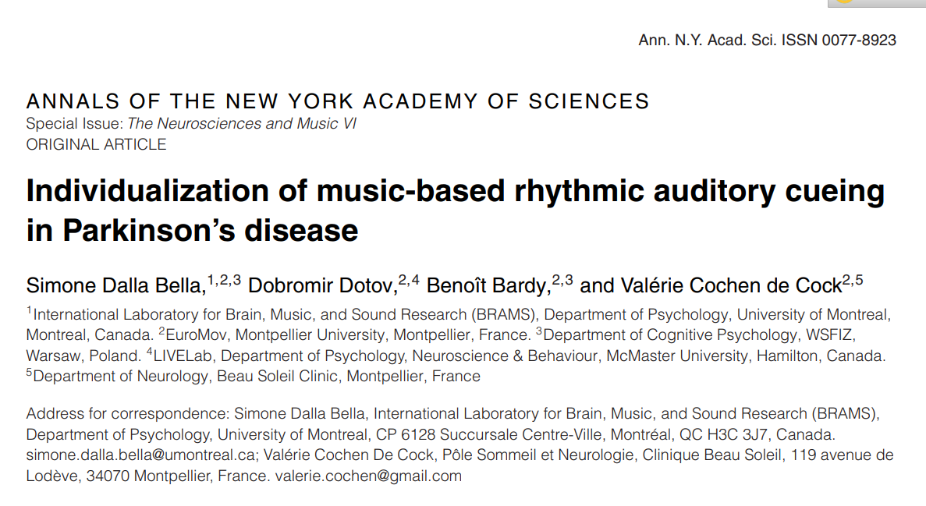
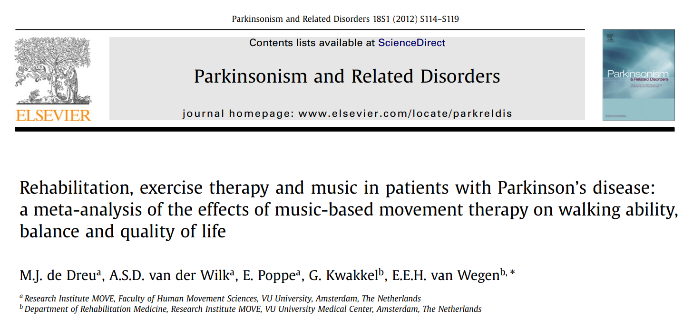
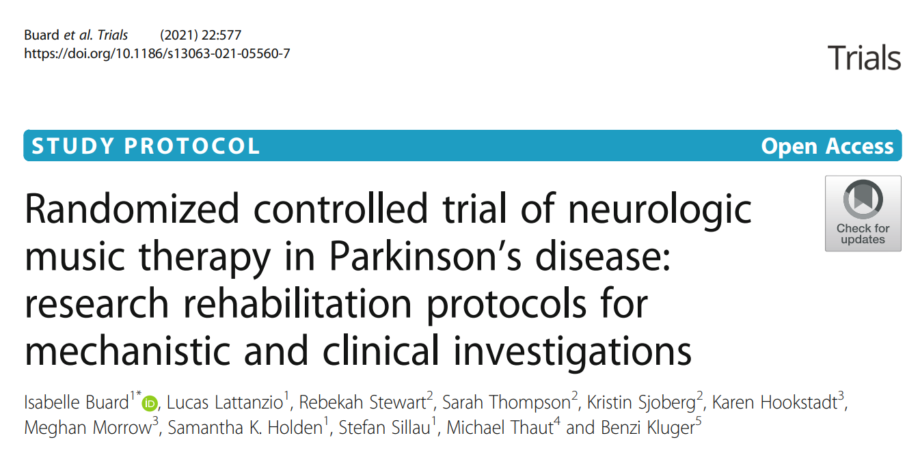

Slide 12
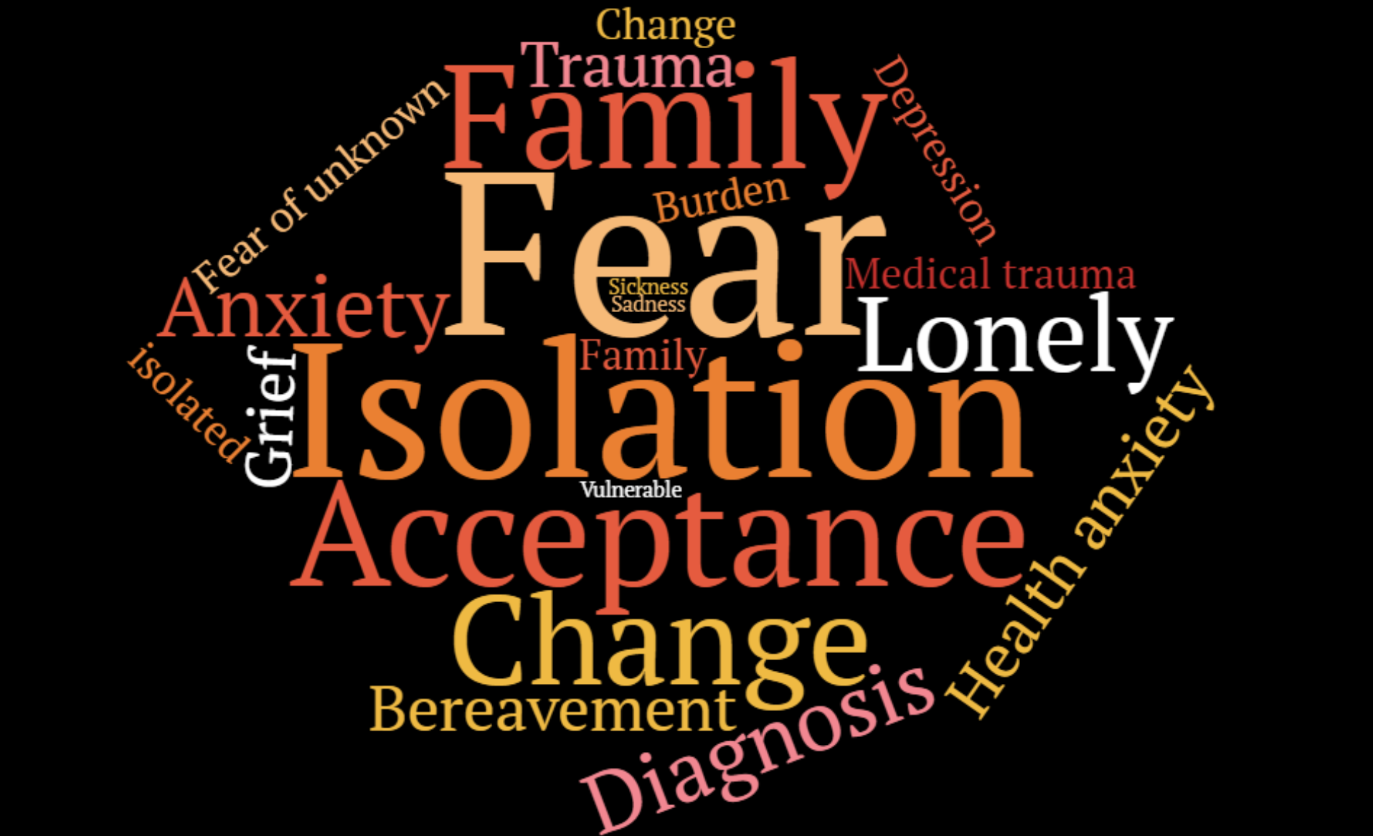

Slide 13
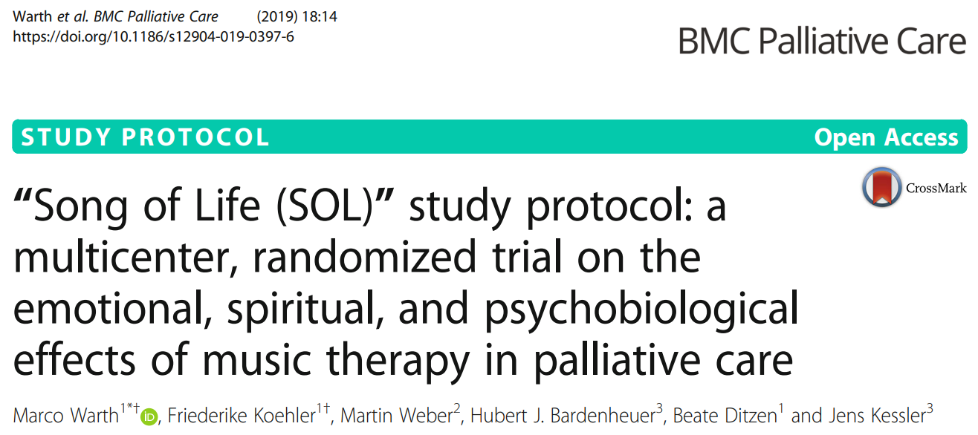
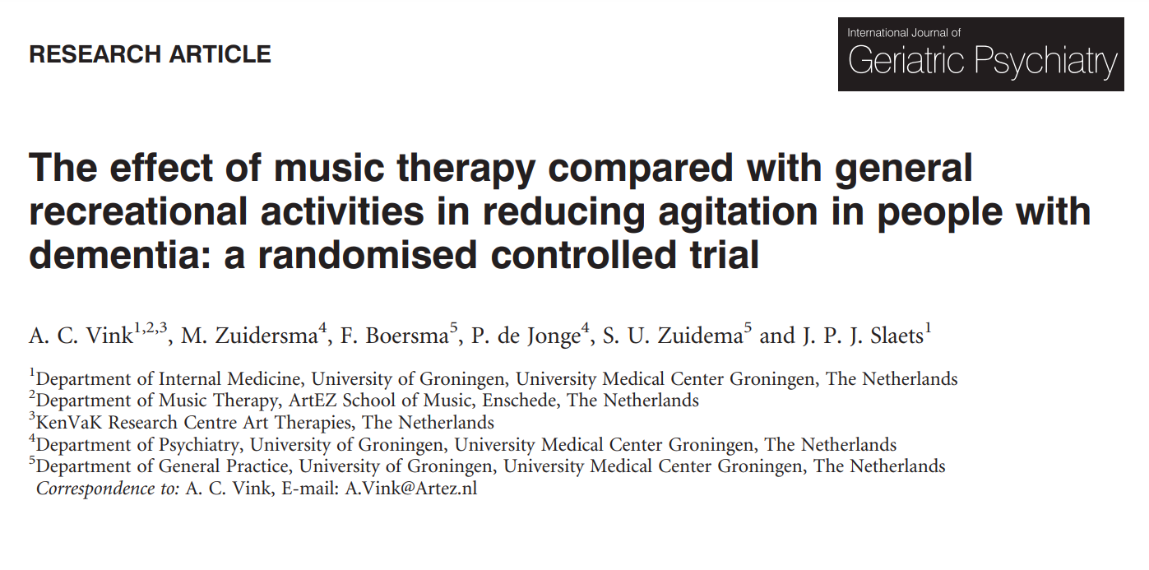
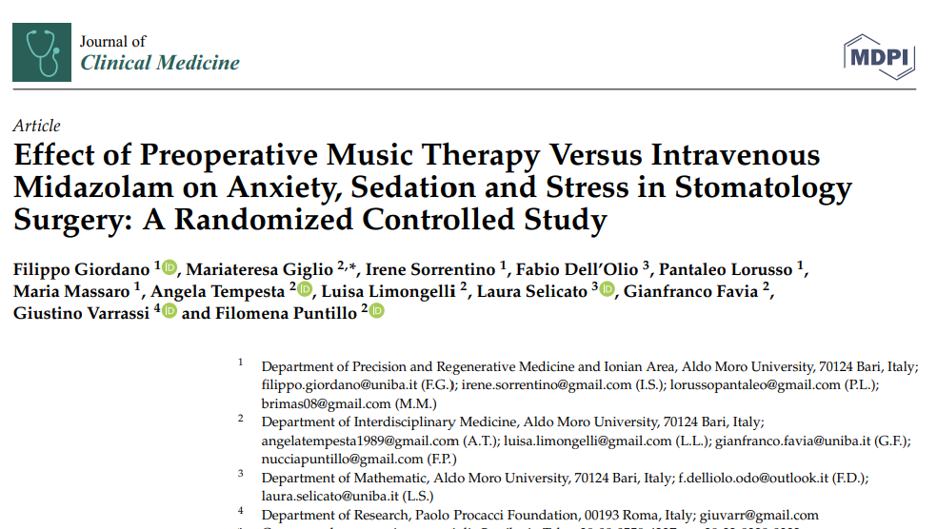
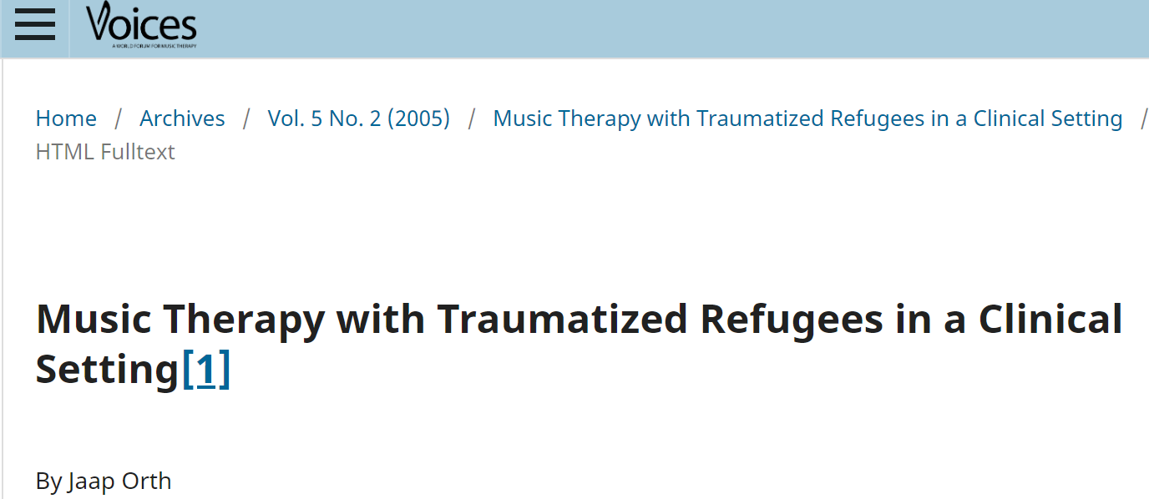

Slide 14
Cognition
Executive functioning: problem solving, processing, planning, turn-taking attention
Activities of daily living
Visual and spatial neglect
Awareness and arousal
Meaningful occupation
Social skills and engagement
Learning and creativity
Memory and remenicence
Music encouraging arousal and alertness.
Musical improvisation, composition, and songwriting are used as therapeutic interventions to recover executive functions, because good processing speed, organization skills, creativity, cognitive flexibility, and self-monitoring are required in these activities.
(Thaut et al., 2009; Tomaino, 2013).

Slide 15
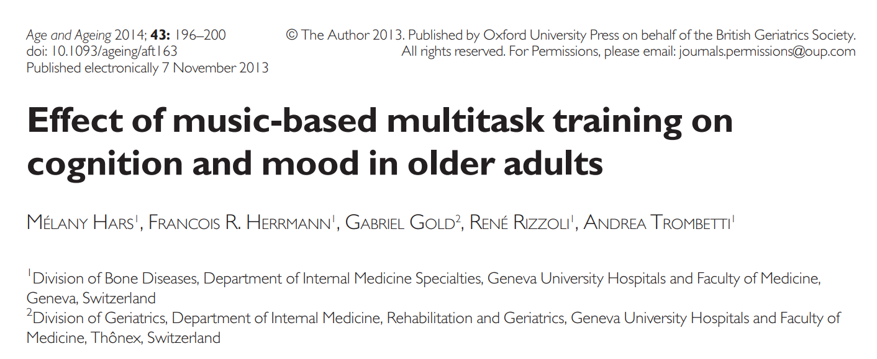
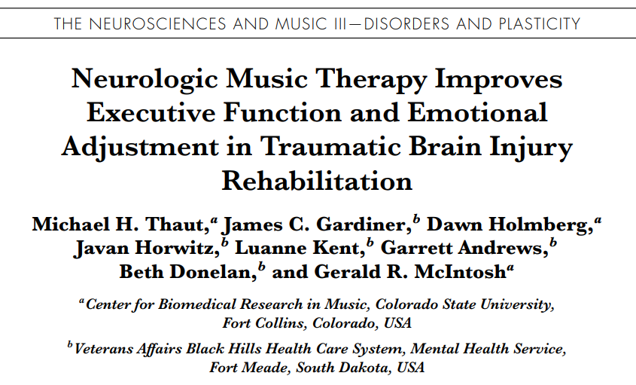
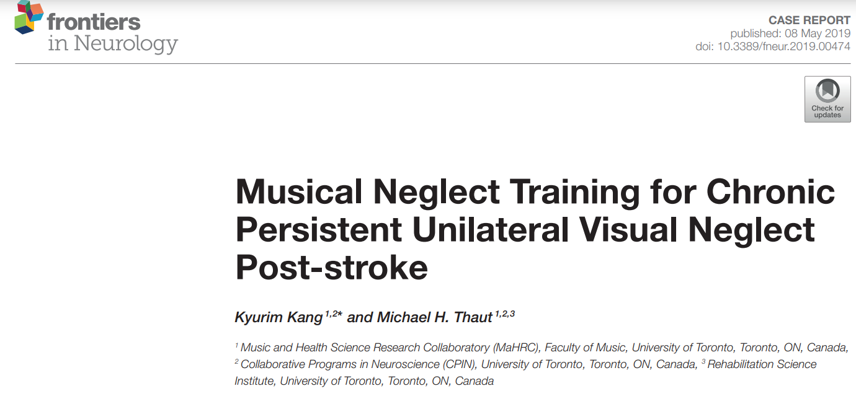

Slide 16
Sensory
Sensory awareness and integration
Familiarity and safety
Carefully considered
Sensory overload
Sensory deprivation
Appropriateness of music
Person centred

Slide 17
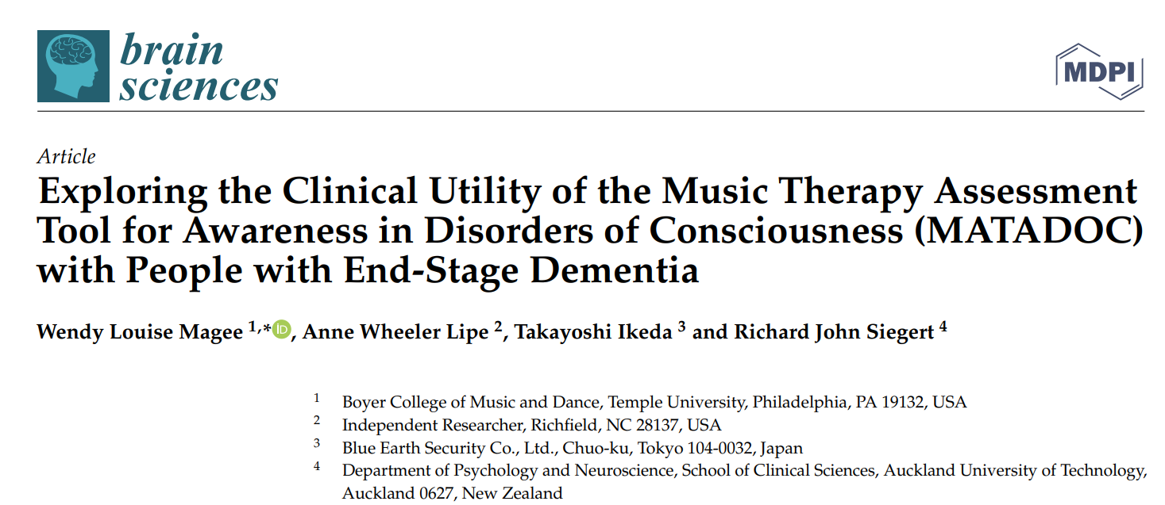
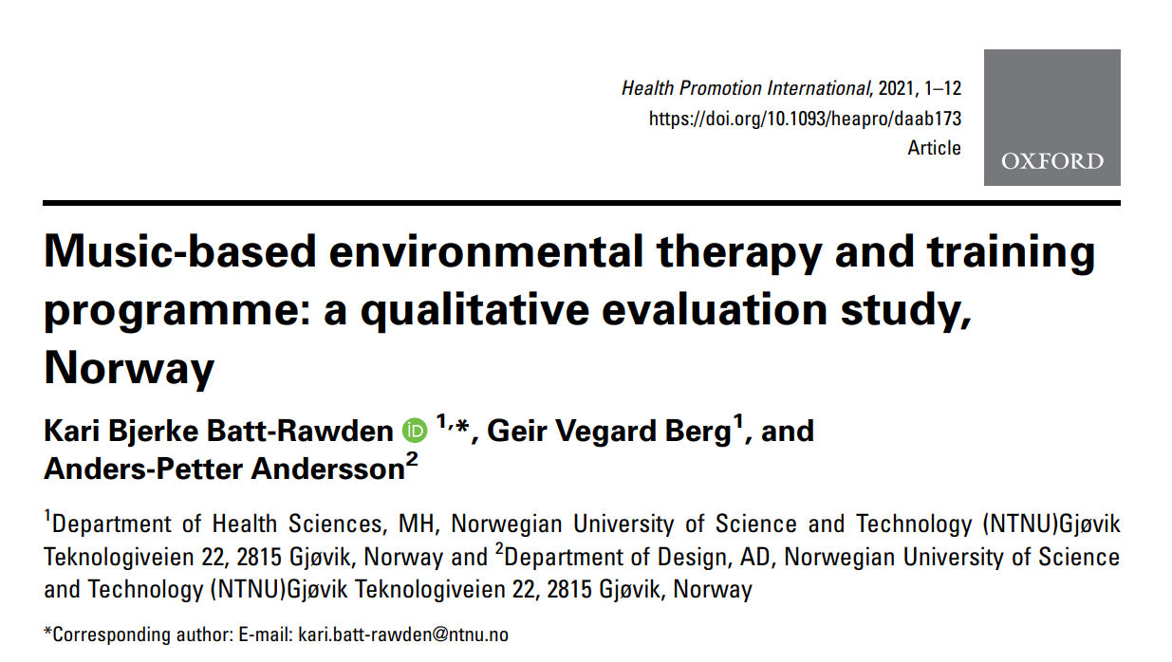
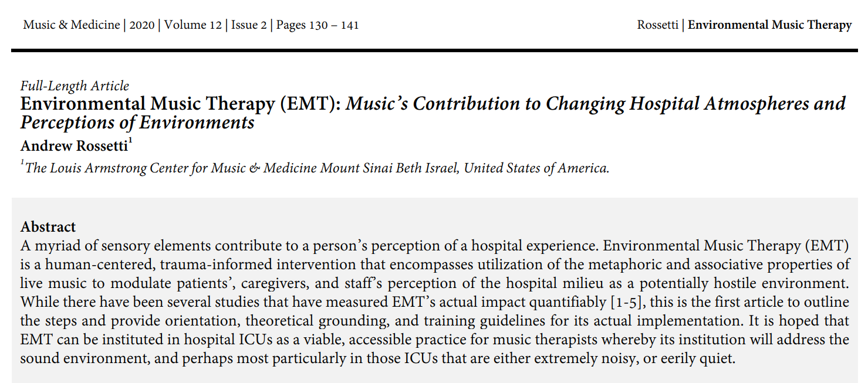

Slide 18
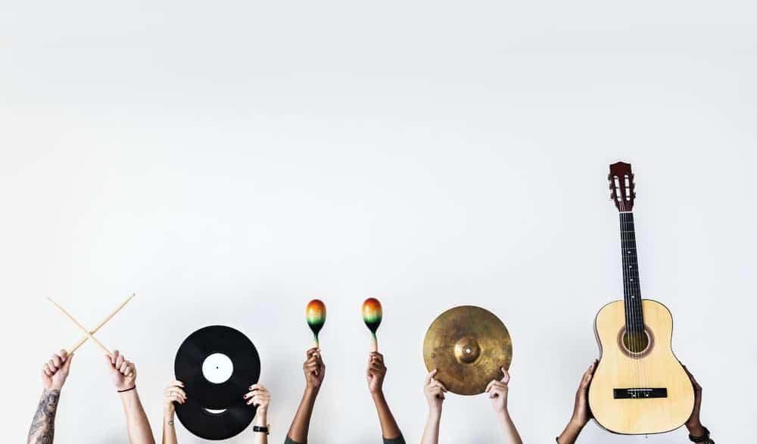
Thank you for listening.

Slide 19
References
Bella, Dotov, D., Bardy, B., & Cock, V. C. (2018). Individualization of music‐based rhythmic auditory cueing in Parkinson’s disease. Annals of the New York Academy of Sciences, 1423(1), 308–317. https://doi.org/10.1111/nyas.13859
Bonilha, Onofre, F., Vieira, M. L., Prado, M. Y. A., & Martinez, J. A. B. (2009). Effects of singing classes on pulmonary function and quality of life of COPD patients. International Journal of Chronic Obstructive Pulmonary Disease, 4(default), 1–8. https://doi.org/10.2147/COPD.S4077
Buard, Lattanzio, L., Stewart, R., Thompson, S., Sjoberg, K., Hookstadt, K., Morrow, M., Holden, S. K., Sillau, S., Thaut, M., & Kluger, B. (2021). Randomized controlled trial of neurologic music therapy in Parkinson’s disease: research rehabilitation protocols for mechanistic and clinical investigations. Current Controlled Trials in Cardiovascular Medicine, 22(1), 577–577. https://doi.org/10.1186/s13063-021-05560-7
Cassileth, Vickers, A., & Magill, L. (2003). Music therapy for mood disturbance during hospitalization for autologous stem cell transplantation - A randomized controlled trial. Cancer, 98(12), 2723–2729. https://doi.org/10.1002/cncr.11842
de Dreu, van der Wilk, A. S. ., Poppe, E., Kwakkel, G., & van Wegen, E. E. . (2012). Rehabilitation, exercise therapy and music in patients with Parkinson’s disease: a meta-analysis of the effects of music-based movement therapy on walking ability, balance and quality of life. Parkinsonism & Related Disorders, 18(S), S114–S119. https://doi.org/10.1016/S1353-8020(11)70036-0
Giordano, Giglio, M., Sorrentino, I., Dell’Olio, F., Lorusso, P., Massaro, M., Tempesta, A., Limongelli, L., Selicato, L., Favia, G., Varrassi, G., & Puntillo, F. (2023). Effect of Preoperative Music Therapy Versus Intravenous Midazolam on Anxiety, Sedation and Stress in Stomatology Surgery: A Randomized Controlled Study. Journal of Clinical Medicine, 12(9), 3215–. https://doi.org/10.3390/jcm12093215
Li, Zhang, Z., Zhou, Z., Su, J., Wu, X., Shi, B., & Xu, J. (2022). Effect of music-based movement therapy on the freezing of gait in patients with Parkinson’s disease: A randomized controlled trial. Frontiers in Aging Neuroscience, 14, 924784–924784. https://doi.org/10.3389/fnagi.2022.924784
Mathew, Sundar, S., Subramaniam, E., & Parmar, P. (2017). Music therapy as group singing improves Geriatric Depression Scale score and loneliness in institutionalized geriatric adults with mild depression: A randomized controlled study. International Journal of Educational and Psychological Researches, 3(1), 6–10. https://doi.org/10.4103/2395-2296.198415
North. (2014). Music, communication, relationship: A dual practitioner perspective from music therapy/speech and language therapy. Psychology of Music, 42(6), 776–790. https://doi.org/10.1177/0305735614552720

Slide 20
Popescu, Stahl, B., Wiernik, B. M., Haiduk, F., Zemanek, M., Helm, H., Matzinger, T., Beisteiner, R., & Fitch, W. T. (2022). Melodic Intonation Therapy for aphasia: A multi‐level meta‐analysis of randomized controlled trials and individual participant data. Annals of the New York Academy of Sciences, 1516(1), 76–84. https://doi.org/10.1111/nyas.14848
Segall. (2017). The effect of group singing on the voice and swallow function of healthy, sedentary, older adults: A pilot study. The Arts in Psychotherapy, 55, 40–45. https://doi.org/10.1016/j.aip.2017.02.007
Tamplin, Baker, F. A., Grocke, D., Brazzale, D. J., Pretto, J. J., Ruehland, W. R., Buttifant, M., Brown, D. J., & Berlowitz, D. J. (2013). Effect of Singing on Respiratory Function, Voice, and Mood After Quadriplegia: A Randomized Controlled Trial. Archives of Physical Medicine and Rehabilitation, 94(3), 426–434. https://doi.org/10.1016/j.apmr.2012.10.006
Warth, Koehler, F., Weber, M., Bardenheuer, H. J., Ditzen, B., & Kessler, J. (2019). “Song of Life (SOL)” study protocol: a multicenter, randomized trial on the emotional, spiritual, and psychobiological effects of music therapy in palliative care. BMC Palliative Care, 18(1), 14–14. https://doi.org/10.1186/s12904-019-0397-6
Vink, Zuidersma, M., Boersma, F., de Jonge, P., Zuidema, S. U., & Slaets, J. P. (2014). Effect of Music Therapy Versus Recreational Activities on Neuropsychiatric Symptoms in Elderly Adults with DementiA: An Exploratory Randomized Controlled Trial. Journal of the American Geriatrics Society (JAGS), 62(2), 392–393. https://doi.org/10.1111/jgs.12682
Zumbansen, Peretz, I., & Hebert, S. (2014). The combination of rhythm and pitch can account for the beneficial effect of melodic intonation therapy on connected speech improvements in Broca’s aphasia. Frontiers in Human Neuroscience, 8, 592–592. https://doi.org/10.3389/fnhum.2014.00592

