Slide 1


Research Stories
Dr. Anusha Yasoda-Mohan
Trinity College Dublin
anusha.mohan@gbhi.org
Tinnitus.eire@gmail.com

Slide 2



Slide 3

HEARING

Slide 4
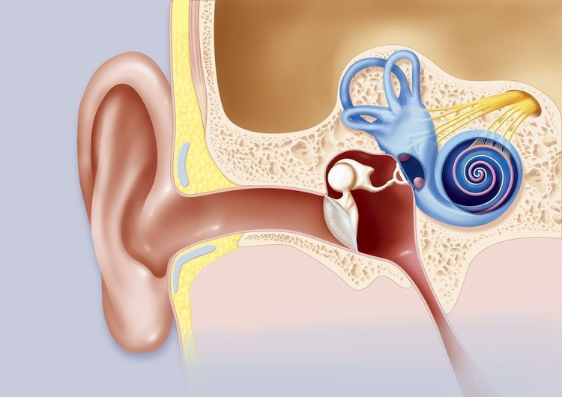
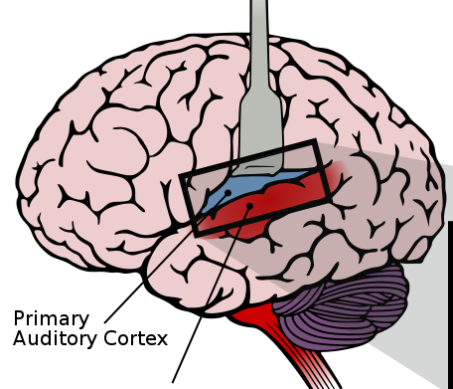


Ear lobe
What is the “Ear” ?
Auditory cortex
Nerve to the brain
Cochlea
(inner ear)
Ear canal
Ear
drum
Smallest bones in the body
Middle ear
Outer ear

Slide 5


Slide 6

MEMORY
Notes:
Conversation slide

Slide 7
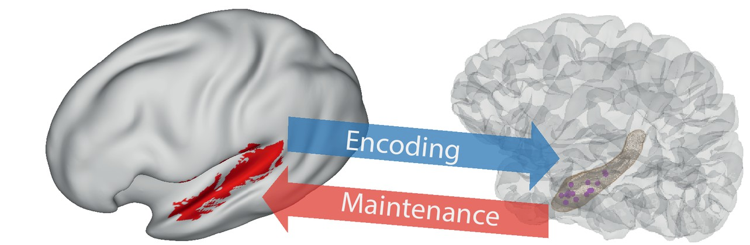
Short term memory
Auditory cortex
Hippocampus
From: eLife: Information flows from hippocampus to auditory cortex during replay of verbal working memory items

Slide 8
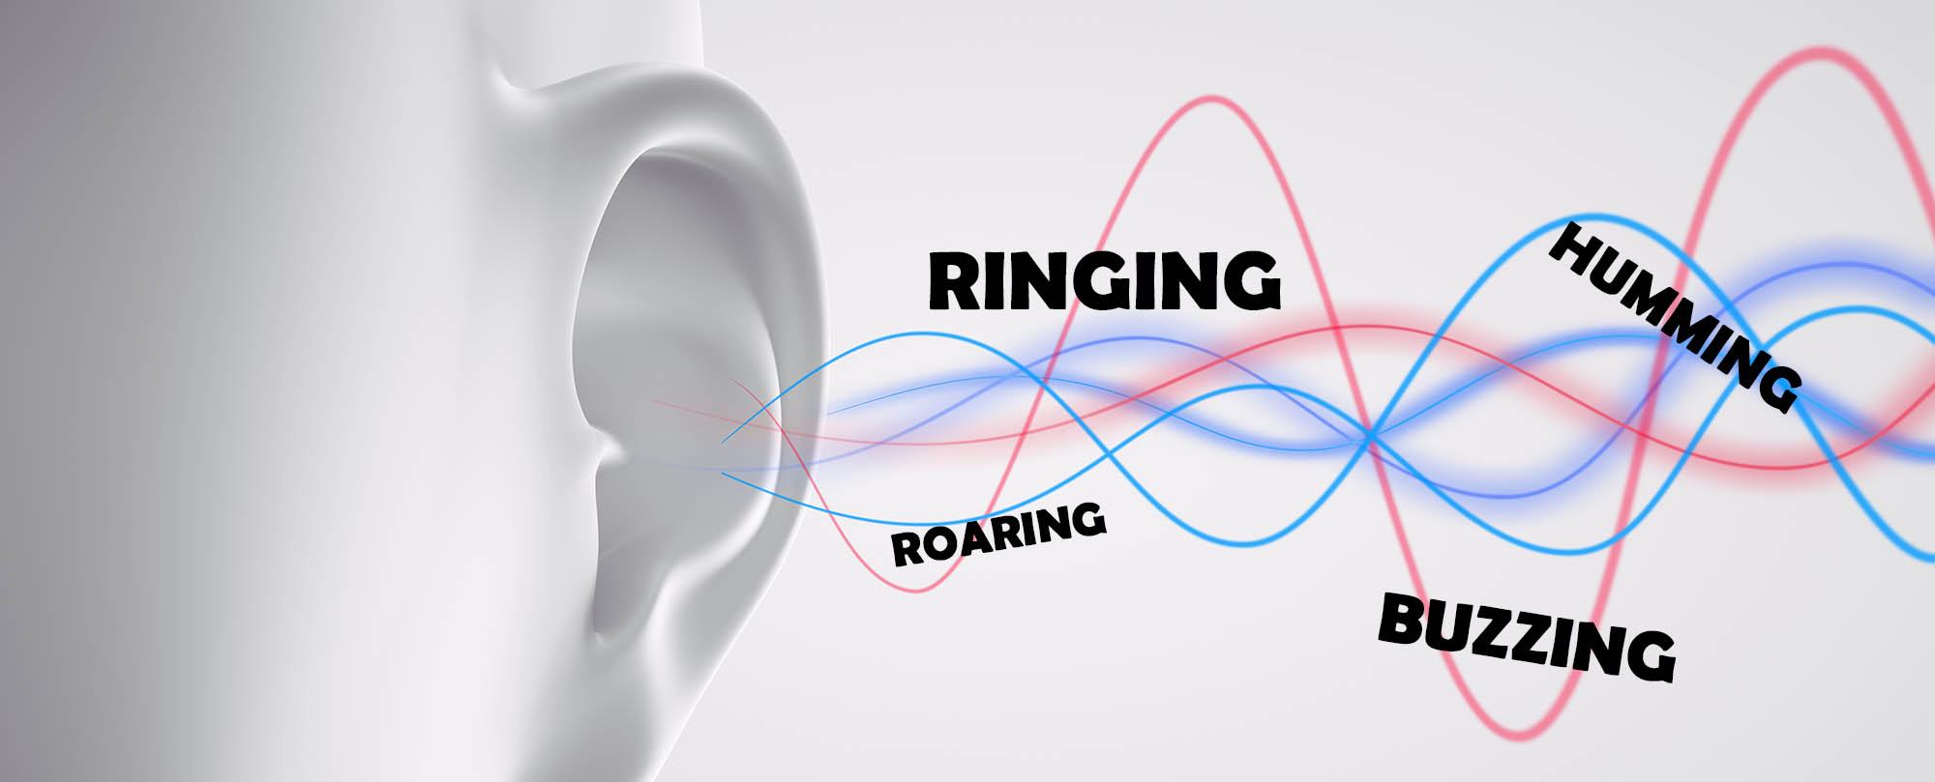
TINNITUS
Notes:
Conversation slide

Slide 9
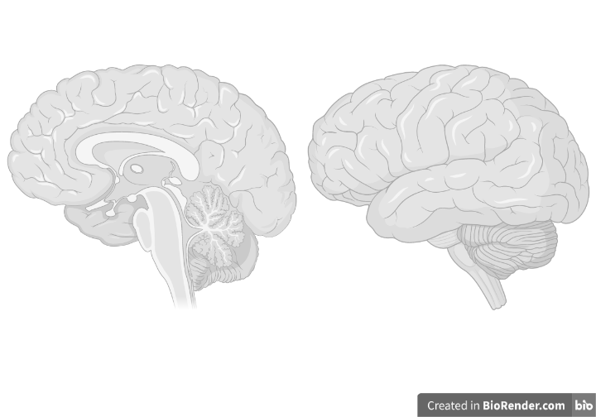
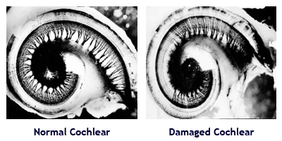
Tinnitus
No Tinnitus
Tinnitus
PFC
PFC
AC
PHC
PFC = Prefrontal cortex
AC = Auditory Cortex
PHC = Parahippocampus
Normal hearing Hearing loss

Slide 10

CONNECTION
Notes:
Conversation slide

Slide 11
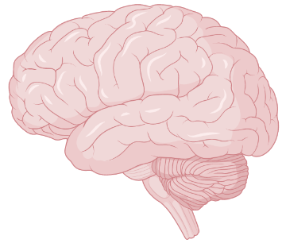
Social connection network
PFC
Insula
AC
HIP
PFC = Prefrontal cortex
AC = Auditory Cortex
HIP = Hippocampus
AMG = Amygdala
AMG
Regions directly connected to hearing
From: Neurobiology of Loneliness: A systematic review in Nature Neuropsychopharmacology

Slide 12
THANK YOU!

