Slide 1
Creative Brainwaves
Dr Anne-Marie Glynn
Chief Operating Officer
Global Brain Health Institute, Trinity College Dublin
1 November 2023

Slide 2
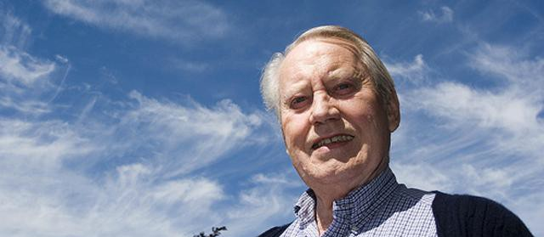
Chuck Feeney
Creative Brainwaves

Slide 3
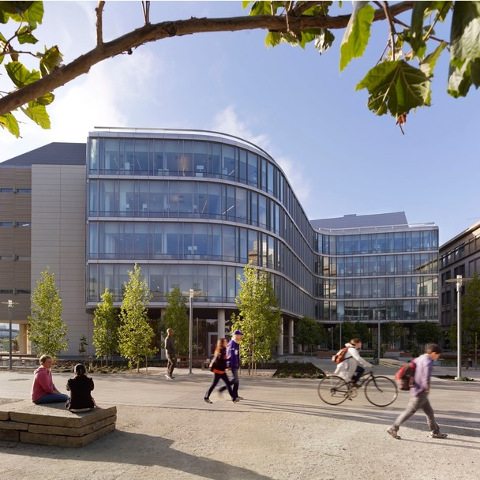
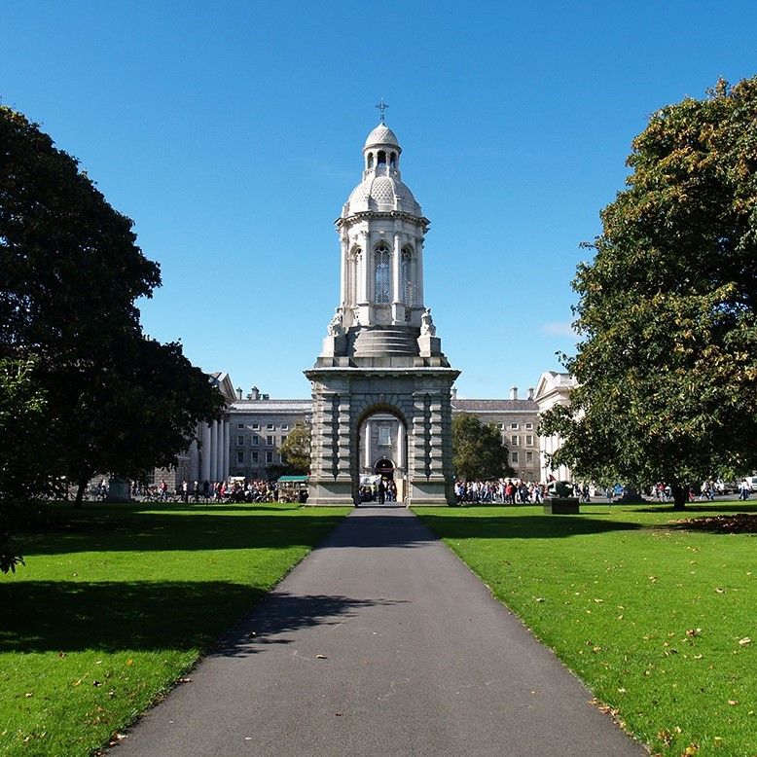
The Global Brain Health Institute
  A global leader dedicated to protecting the world’s aging populations from threats to brain health
  Founded in 2015 through funding from the Atlantic Philanthropies
  Founding sites at UCSF and Trinity
  Transdisciplinary leadership training program and life-long fellowship
Creative Brainwaves

Slide 4
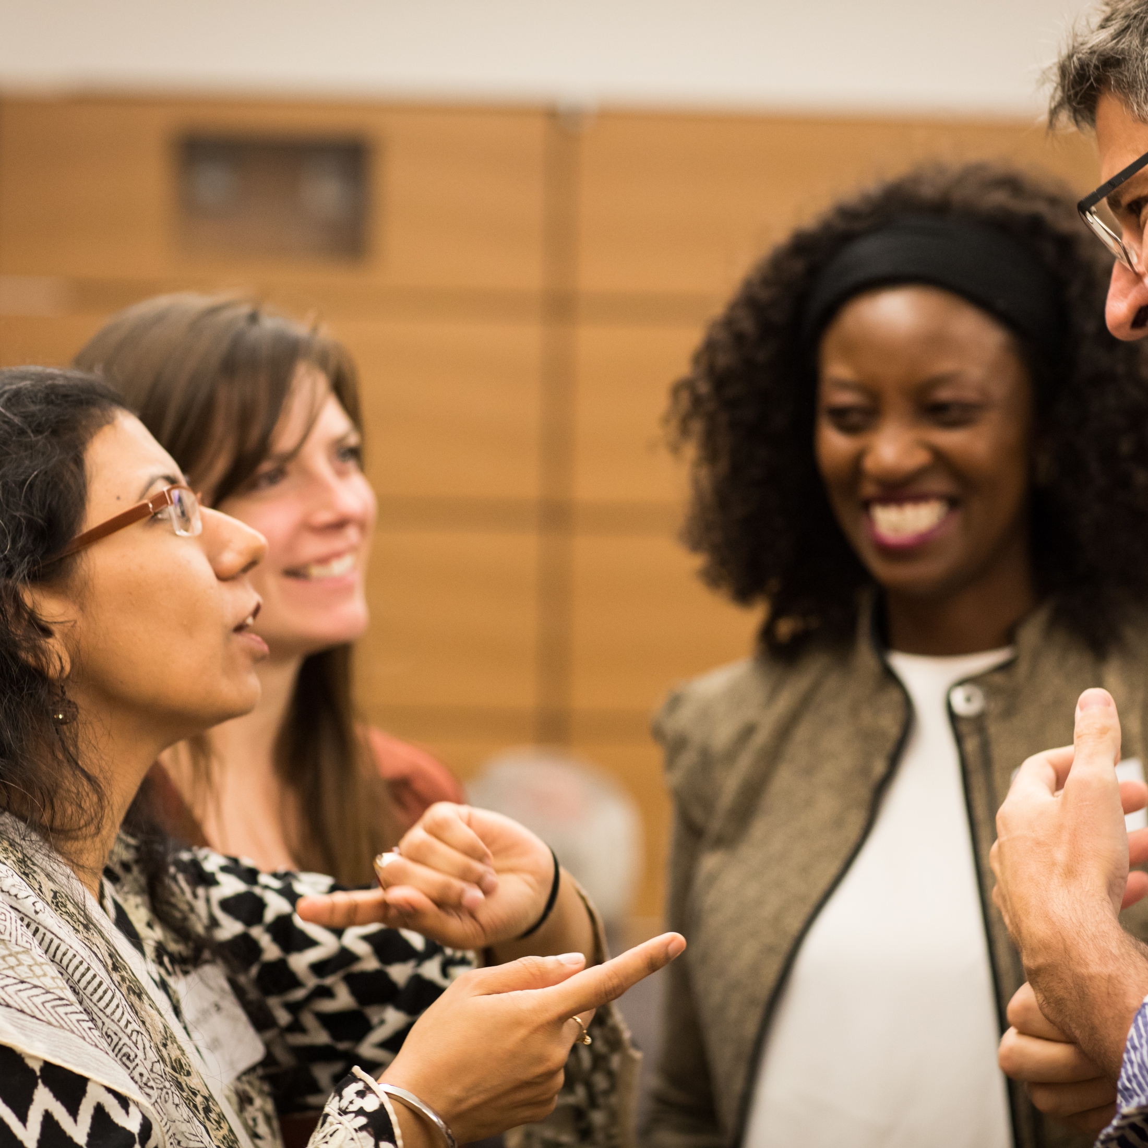
The Global Brain Health Institute (GBHI)
GBHI brings together a mix of
    disciplines
    professions
    backgrounds
    skill sets
    perspectives
    and approaches to develop new solutions.
Creative Brainwaves

Slide 5
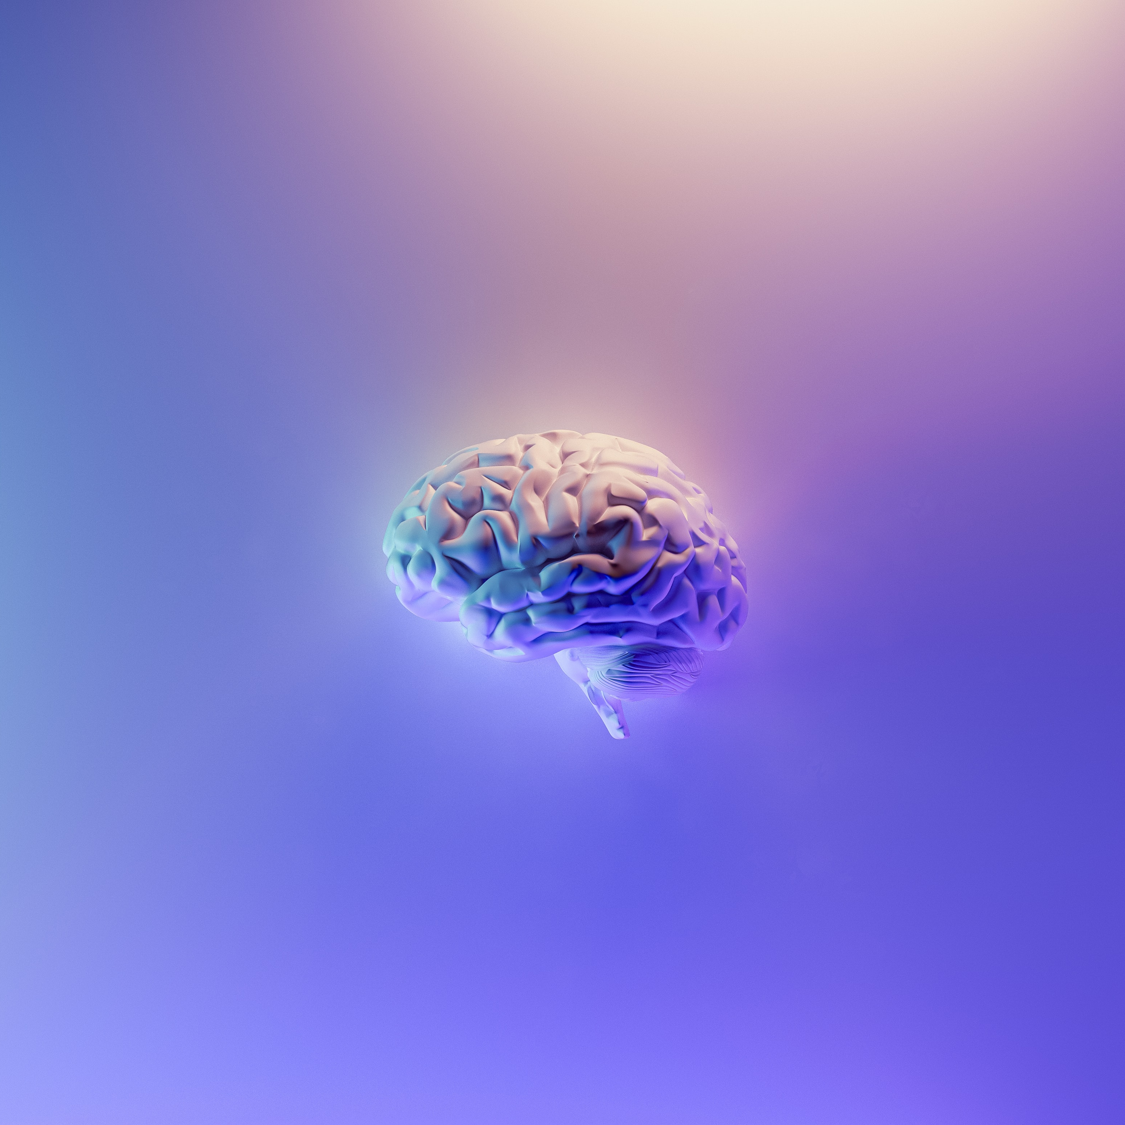
What is Brain Health?
The state of brain functioning allowing a person to realize their full potential over the life course, irrespective of the presence or absence of disorders.
Not simply the absence of disease
Getting the most out of your brain
Reducing risks
Protecting Building reserve
Creative Brainwaves

Slide 6
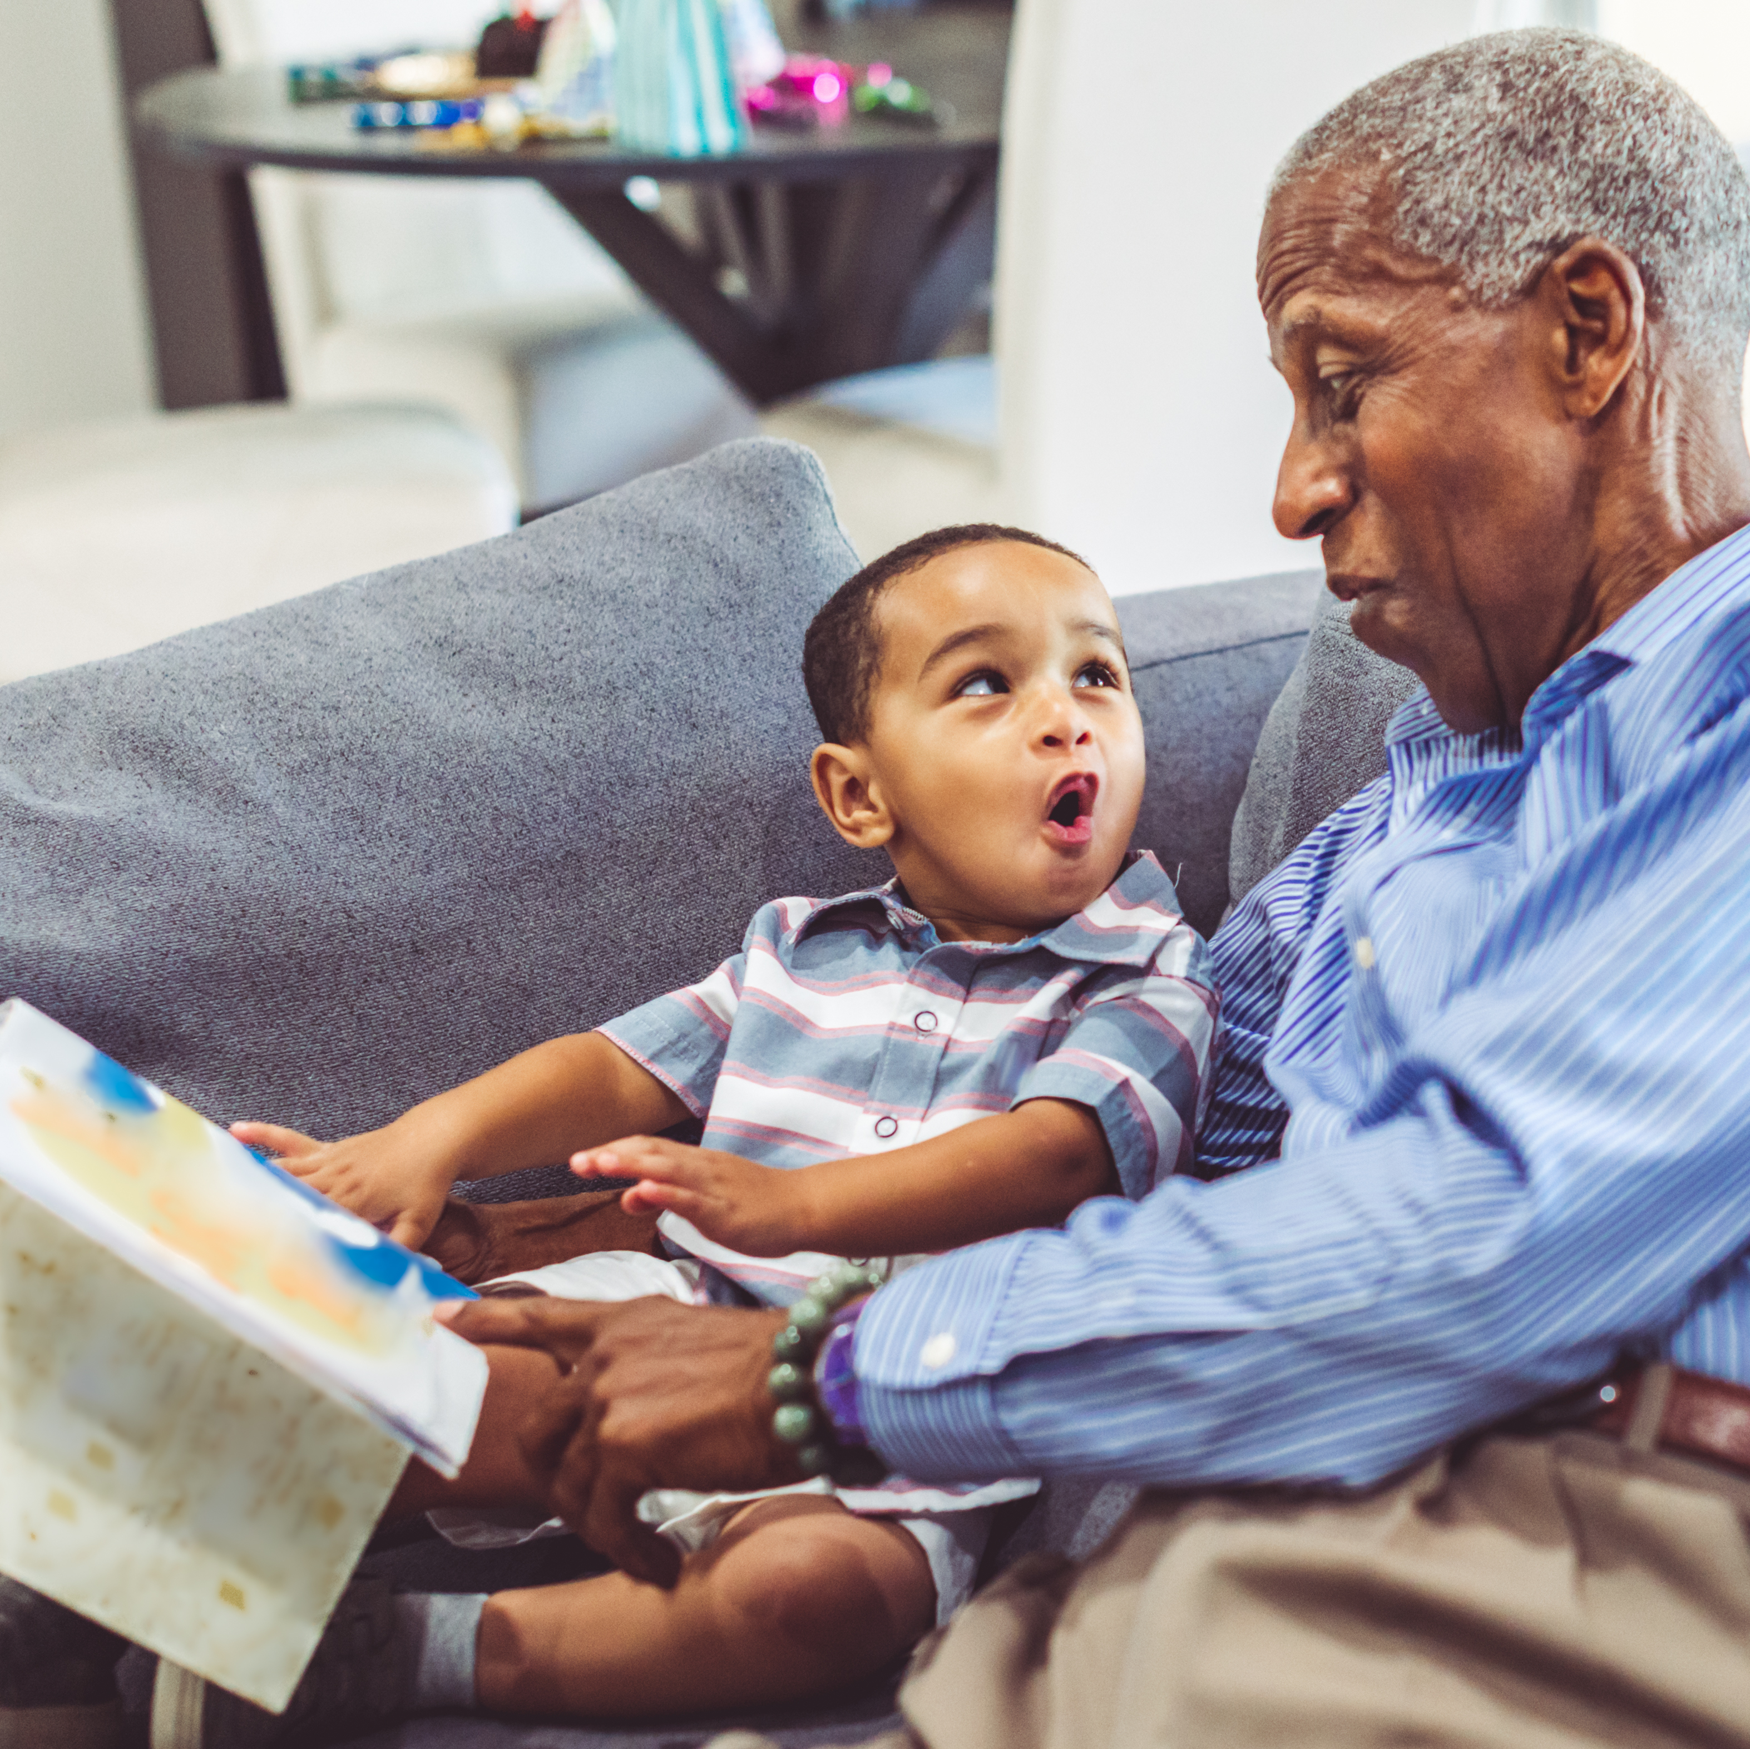
Mind Your Brain
Our most important asset
Brain plasticity
Risk and protective factors over the lifespan
No health without brain health
Creative Brainwaves

Slide 7
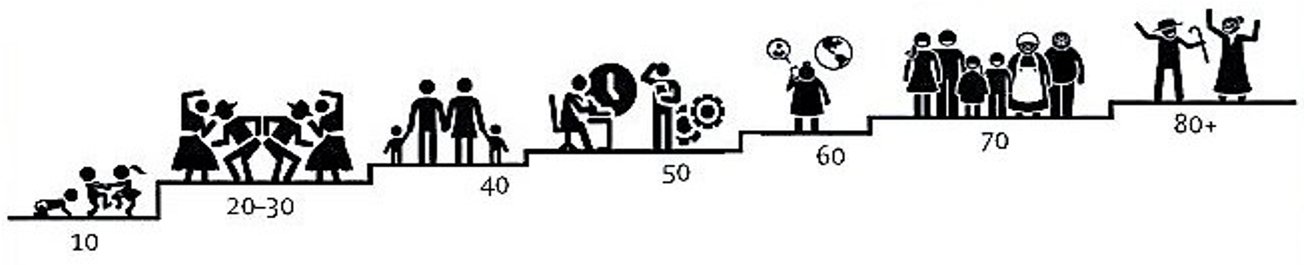
Modifiable Risk Factors for Brain Health Across the Life Span
Little Mental stimulation
Social isolation
Sensory deficits
Cardiovascular & cerebrovascular disorders
Depressions
Hypertension
Physical Inactivity
Job Strain
Diabetes
Diet
Smoking
Head Trauma
Obesity
Low Education
Personality
Alcohol
Passive jobs
Pollution
Socioeconomic status
Prenatal environment
Creative Brainwaves

Slide 8
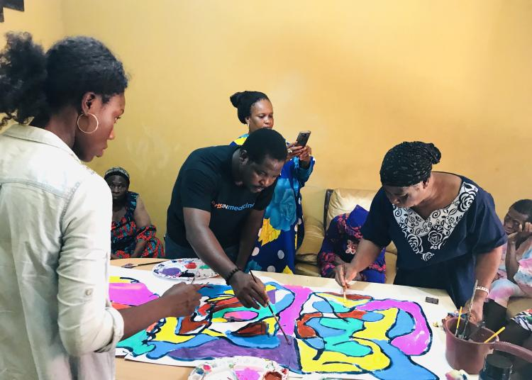
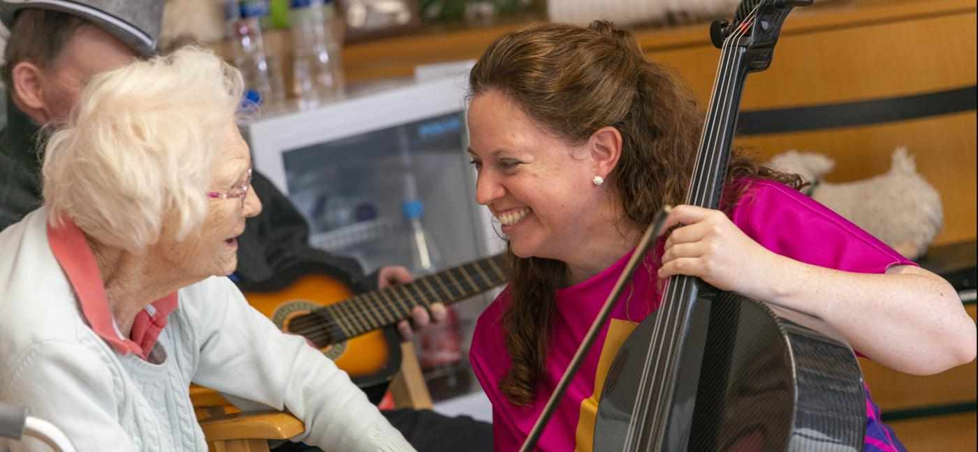
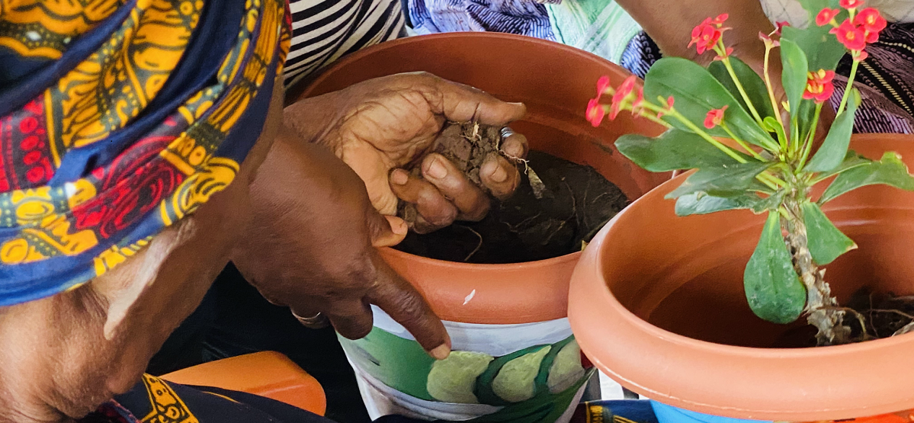
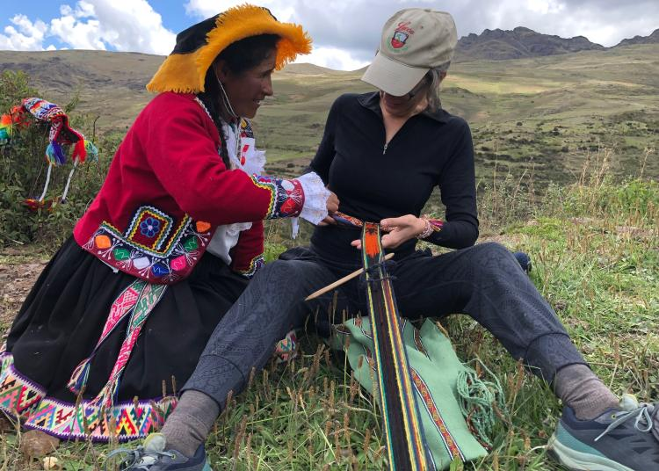
GBHI Embraces Arts & Creativity for Brain Health

Slide 9
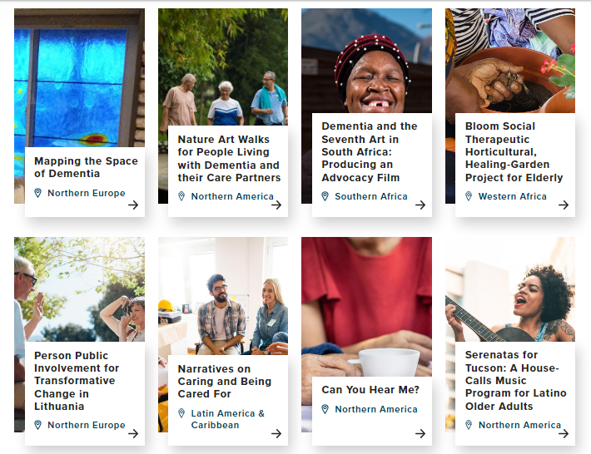
Nurturing Creative Brain Health Leaders & Projects
43 creative Atlantic Fellows from 14 countries
Artists, musicians, photographers, dancers, film makers and more
37 creative pilot projects funded around the world
Creative Brainwaves

Slide 10
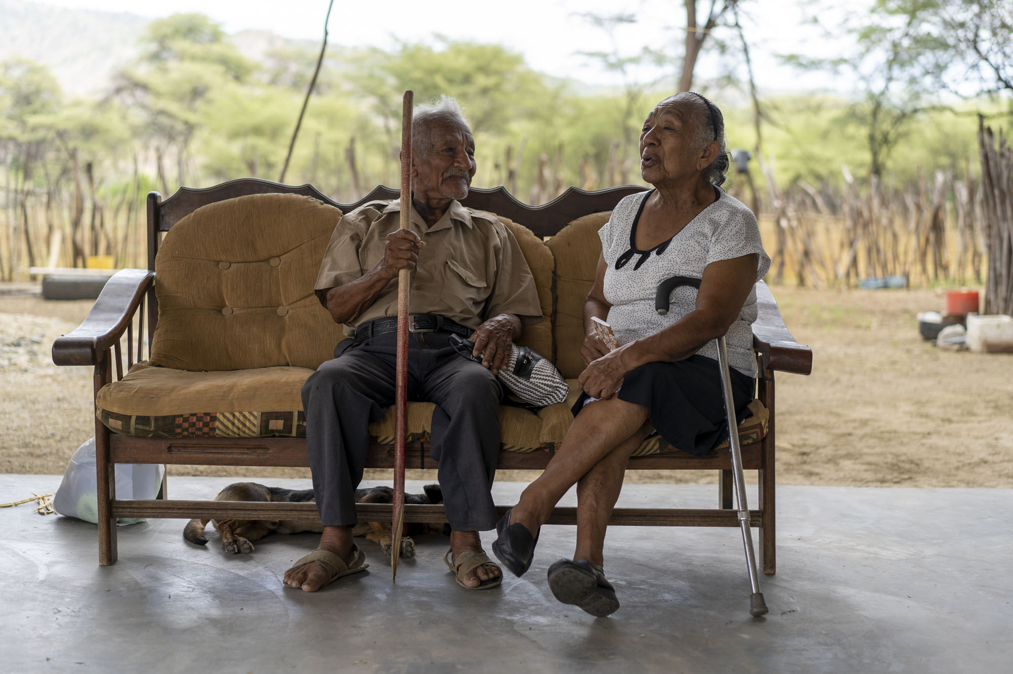
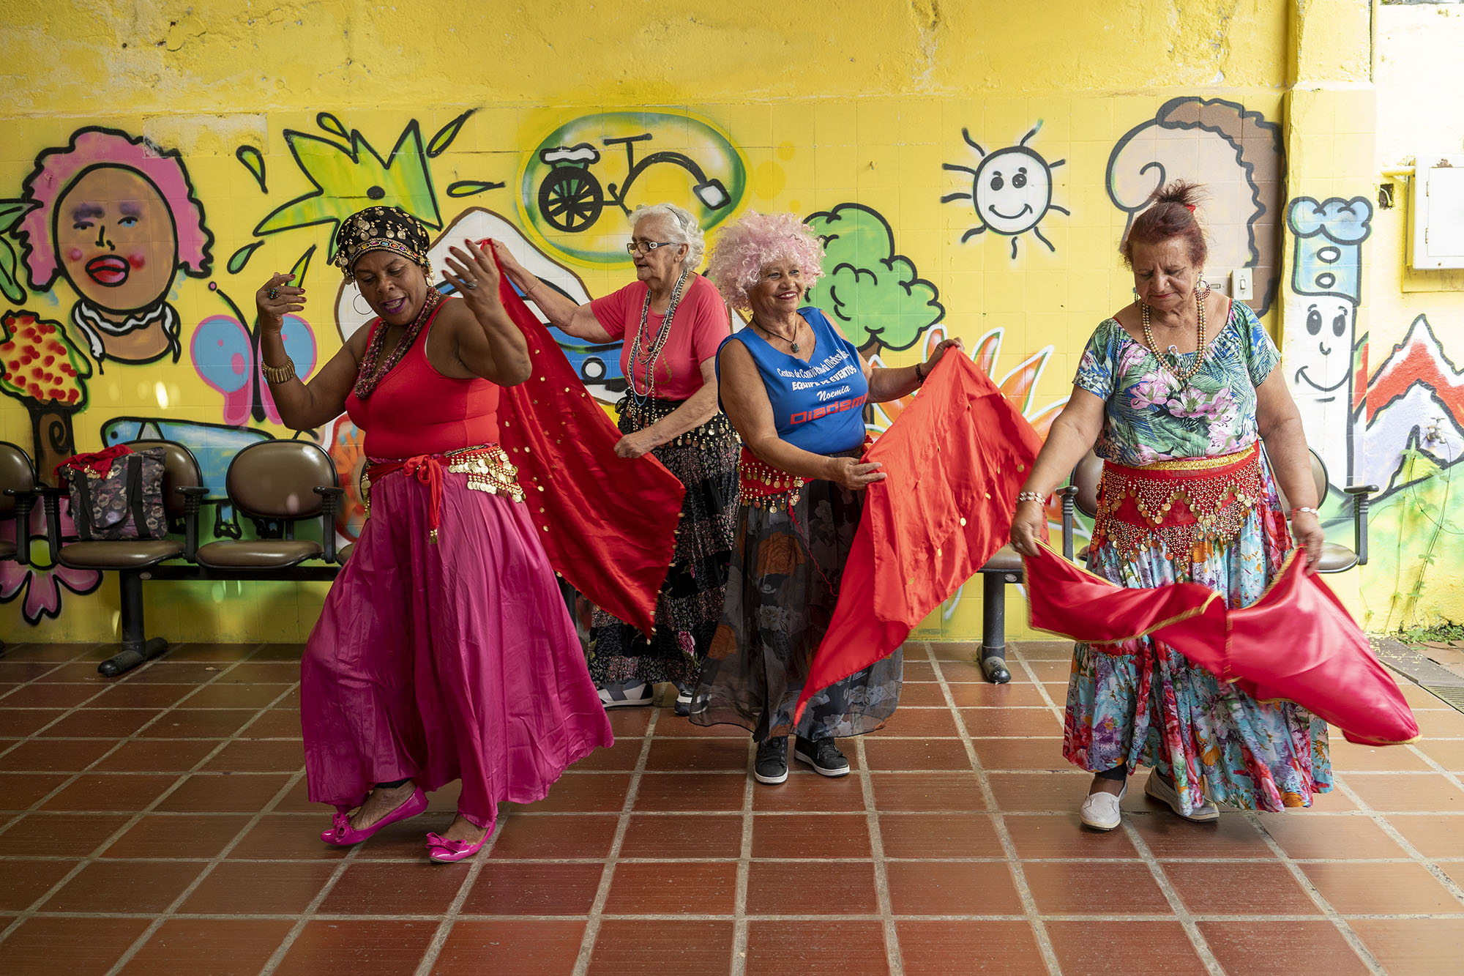
GBHI Community Working Together—Across Disciplines
Photographer Alex Kornhuber and neurologist Maritza Pintado-Caipa
Built a picture of how Peruvians age across the country
Raising awareness of dementia and other neurological conditions

Slide 11
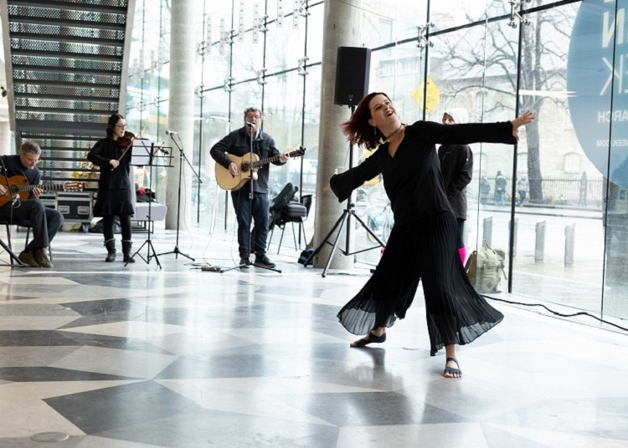
Creative Brain Week
Showcases innovation at the intersection of neuroscience and the arts.
Raises awareness of the powerful relationship between brain health and creativity.
Join us 4-9 March 2024, online or in person at Trinity College Dublin.
Notes:
Now in its second year Creative Brain Week, a GBHI innovation at Trinity College Dublin, has rapidly achieved local and international significance in its exploration of how brain science and creativity collide.
It is the world’s first such festival celebrating the creativity-neuroscience-psychology-health links which are critical for wellbeing and economic development.
stimulates research into how creative practice might mitigate the negative effects of poverty, low education and disease on brain function and quality of life
Creative Brain Week was presented in association with the Jameel Arts & Health Lab, in collaboration with the World Health Organization and with support from Creative Ireland and the Atlantic Institute.

Slide 12
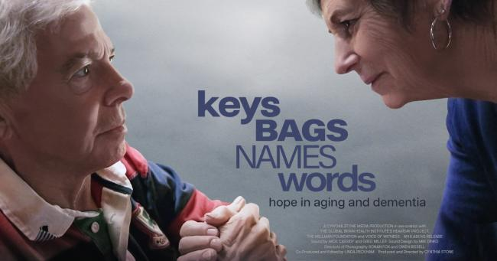
Keys, Names, Bags, Words
Inspired by the “hear/say” oral history project
Intimate profiles of people living with dementia and their care partners.
Shifts the narrative of fear to one of hope and action
Coming to the LexIcon on 23 November.
Creative Brainwaves
Notes:
Dementia is one of the greatest fears of people today. This documentary shifts that narrative of fear and hopelessness to one of hope and action.
There are things we can do as individuals to reduce our risk of developing dementia. There are ways to connect meaningfully with our loved ones, even if they no longer recognize us. We can live a high quality of life after diagnosis.
Keys Bags Names Words shows intimate profiles of people living with dementia and their care partners. You’ll meet doctors discussing what you can do in your life to support brain health and prevent cognitive decline. And you’ll meet musicians and artists, scientists and policy experts from around the world engaged in a bold approach to tackling one of the greatest global challenges for health and social care in the 21st century, dementia and brain health. This film is not a lament to loss, but a quirky and inspiring celebration of the human spirit.
Engaging Dementia invites you to a special free screening of the film 'Keys Bags Names Words' on Thursday 23rd November in dlr LexIcon.
This powerful documentary about people living with dementia, tells their stories of the heartbreak, and hope, in aging. This new international film, produced and directed by award-winning filmmaker Cynthia Stone, explores the ways we can protect our brain health, connect with our loved ones, and live a higher quality of life; even after diagnosis.
Opening words will be provided by Irish Global Dementia Ambassador, Dr. Helen Rochford-Brennan; and we will have a discussion panel following the screening with various expert speakers including Deputy Executive Director of Global Brain Health Institute, Brian Lawlor. Information stands also will be present at the venue.
Places can be booked via Eventbrite at the following link:https://www.eventbrite.ie/e/keys-bags-names-words-tickets-746143734997?aff=oddtdtcreator
A limited number of tickets will also be available on the door.
Location: dlr LexIcon, Dun Laoghaire, A96 H283, ground floor screening room.
Time and Date: 23rd Nov 2023. Doors open at 6:30pm and proceedings start at 7pm.
Engaging Dementia wishes to extend sincere thanks to Age Friendly Ireland and the dlr LexIcon, whose kind support has made this event possible.

Slide 13
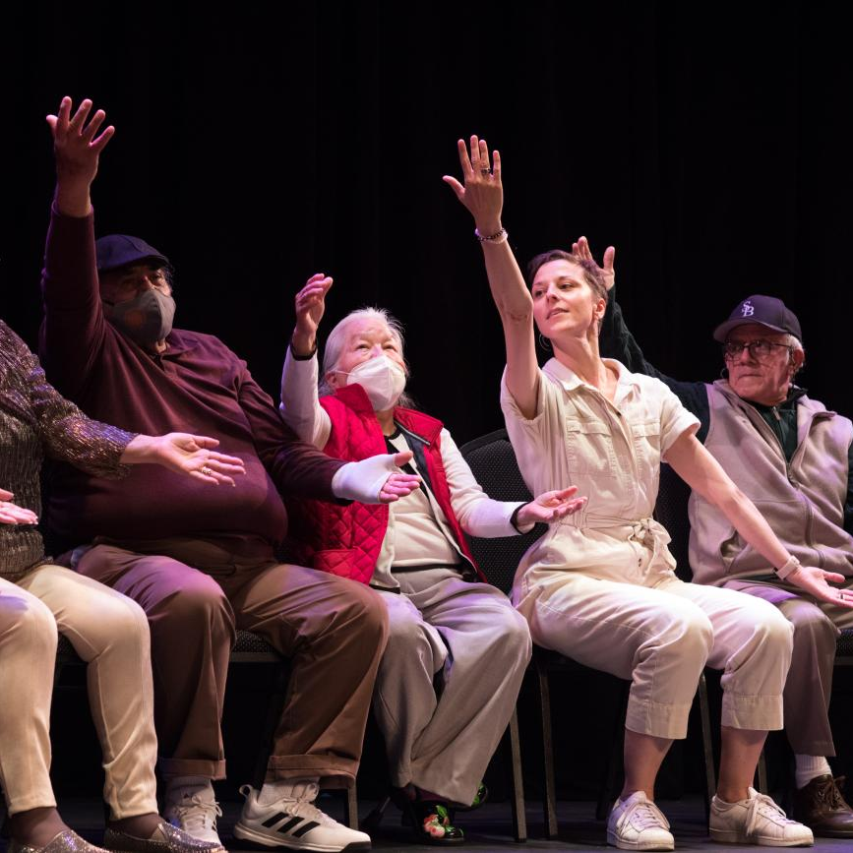
Arts & Creativity Offers Hope
Arts and creativity can be for everyone
Promotes equity and inclusion
Change narrative: capacity not incapacity
Improve health care environment
Creative Brainwaves

Slide 14
Arts, music & creativity: how does it work for brain health?

Slide 15

Evidence for arts, music & creativity for brain health
Making music, writing, dancing and crafts can enhance a person’s mood and mental health
Art interventions can help people with dementia,
post-traumatic stress disorder, anxiety, depression leading to better physical, mental, and emotional wellbeing
In Parkinson’s disease, a pre-post observational study with art therapy has been shown to improve cognitive, motor and visuospatial functioning
Over the longer term, engagement with the arts and culture has been associated with a decreased risk of developing dementia, most likely related to increased cognitive reserve
Creative Brainwaves

Slide 16






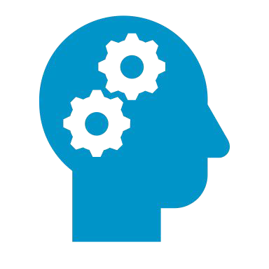
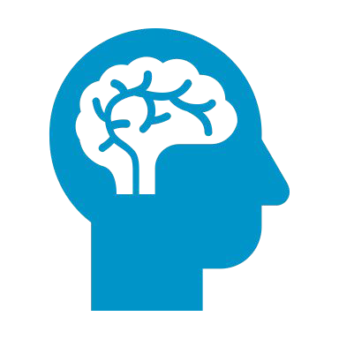
The power of arts, music & creativity
ACTIVITY & AGENCY
DECREASE ANXIETY
PROVIDE MEANING
HELP PROCESS EMOTIONS
CONNECTION & INCLUSION
IMPROVES THE WELLBEING OF CAREGIVERS
AWARENESS
FOSTERS EMPATHY
Creative Brainwaves

Slide 17
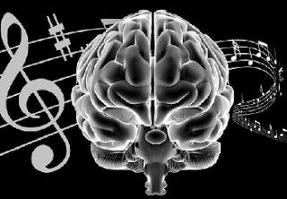
Music gives you a full brain work out It increases blood flow, dopamine
release, serotonin levels, lowers stress hormones & your Blood Pressure!

Slide 18
Mounting evidence for the benefit of listening to music, playing a musical instrument, and singing, for your brain health

Slide 19
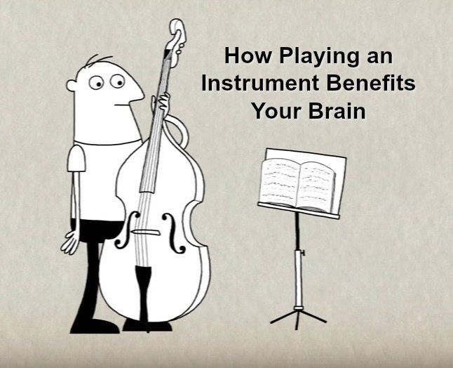
Inside the musician’s brain: playing an instrument
Builds more connections Rewards the brain
Improves overall brain health
Some cognitive abilities gets better
Creative Brainwaves

Slide 20
Arts and creativity can build brain health and wellbeing and help turn the fear and stigma of dementia inside out

Slide 21
GBHI.ORG

